Slide 1
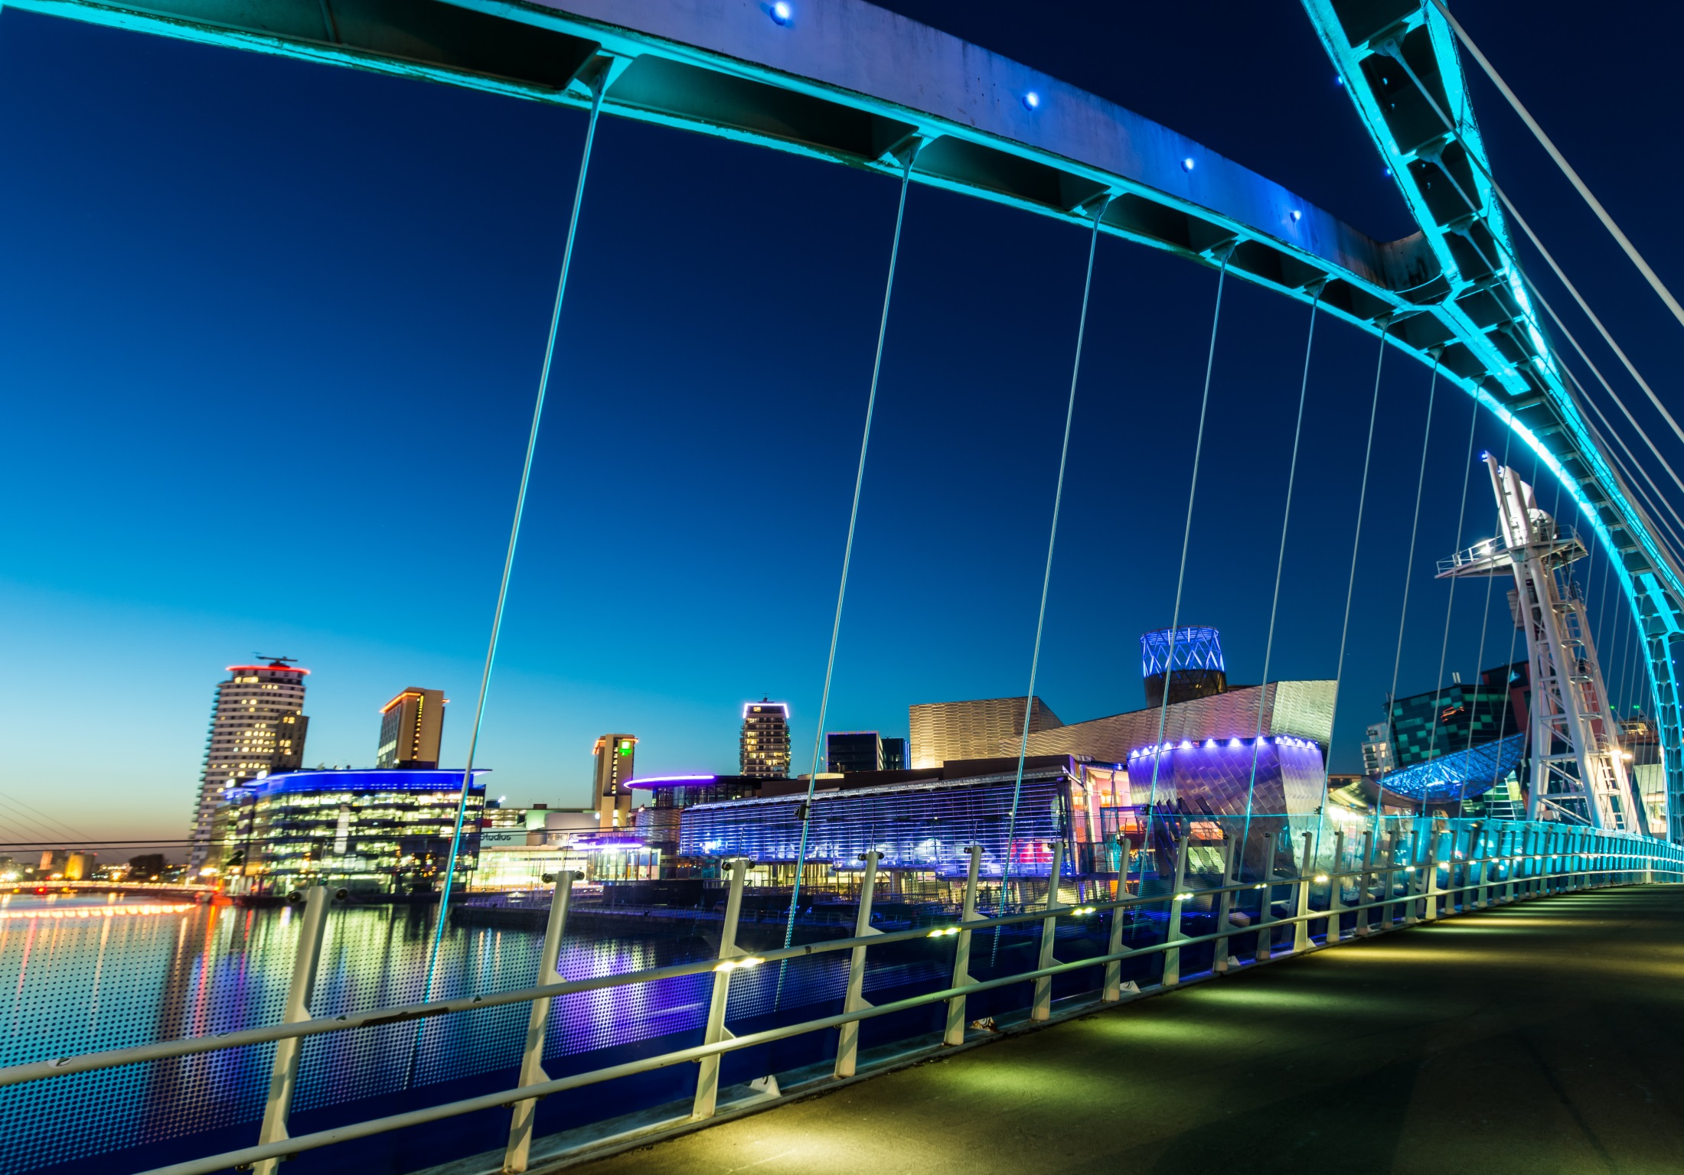
Welcome
GMLPN Member Consultation
Feedback
Focus Groups

Slide 2
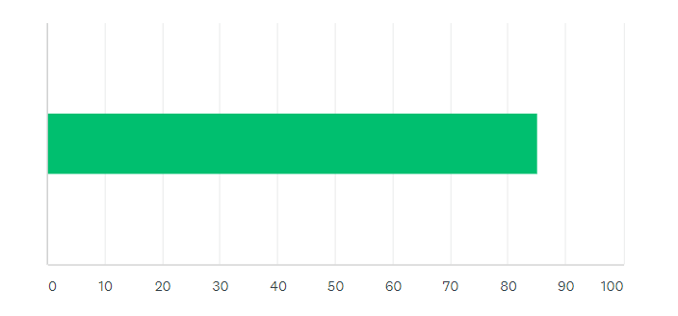
GMLPN Member Consultation - Vision
‘Working with our members and partners, our Vision is to help Greater Manchester reach its economic and social potential by supporting the skills system to enable people to fulfil their aspirations and businesses to achieve sustainable growth.’
Members rated this vision 85/100

Slide 3
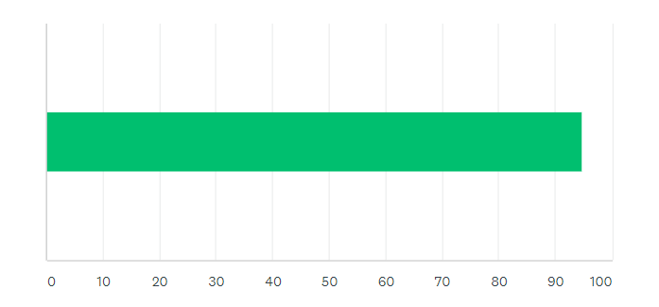
GMLPN Member Consultation - Values
Members rated ‘Responding Positively to change’ and ‘Representing our members fairly’ as the most important values with 95/100

Slide 4
GMLPN Member Consultation - Priorities
Members rated ‘Influencing and Informing’ as the most important priority for the Network
Notes:
20% responded
E.g.
Network Meeting – members want more time to network

Slide 5
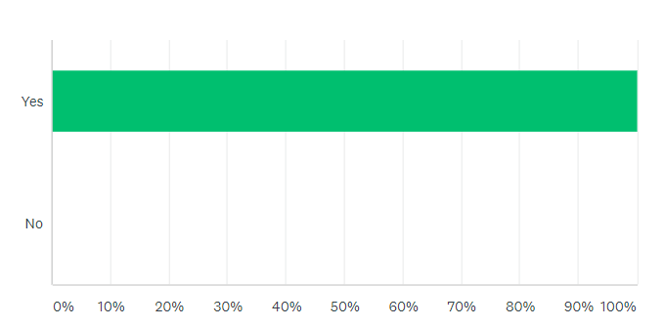
GMLPN Member Consultation – Other Feedback
71% of respondents prefer the network to keep the name GMLPN
Members rated their satisfaction with the service at 85/100
86% think the level of communications such as bulletins is right
Members rated the usefulness of Network Meeting updates at 78/100
100% of respondents believe they receive value for money from their membership:
Notes:
20% responded
Network Meeting – members want more time to network

