Slide 1
Seetec Outsource
Poppy Appeal 2020
We will remember them

Slide 2
We will remember them
Darrin Stevens - Royal British legion
Cherished Memories
Our Proud Seetec Family
Bingo
Scavenger Hunt
Raffle
Target

Slide 3
LIVE ON
TO THE MEMORY OF THE FALLEN
AND THE FUTURE OF THE LIVING
Notes:
Welcome the audience to the presentation, explain who you are and why you are speaking to them today. Keep the tone light and appropriate for your audience, and avoid overuse of jargon and acronyms.

Slide 4
The British Legion was formed on 15 May 1921
(Duston & District was formed in 1947)
We help members of the Royal Navy, British Army, Royal Air Force, Veterans and their families ALL year round.
We also campaign to improve their lives, organise the Poppy Appeal and
Remember the fallen.

Slide 5
When you go home tell them of us and say: for your tomorrow, we gave our today.
Help us help them
https://www.justgiving.com/fundraising/lesley-muskett1
LIVE ON
TO THE MEMORY OF THE FALLEN
AND THE FUTURE OF THE LIVING
Notes:
Welcome the audience to the presentation, explain who you are and why you are speaking to them today. Keep the tone light and appropriate for your audience, and avoid overuse of jargon and acronyms.

Slide 7
Seetec Outsource
Poppy Appeal 2020
We will remember them
Let us look through some cherished memories

Slide 8
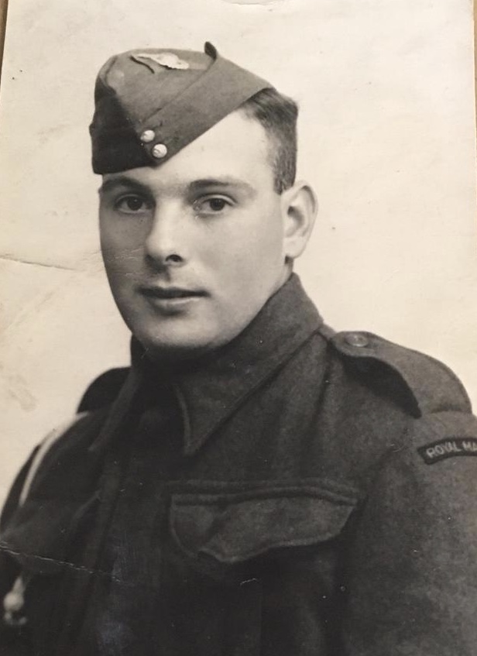
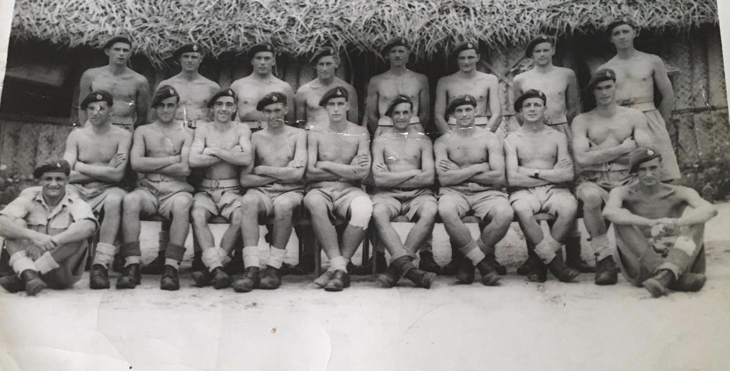
Cherished Memories
Clare Ramsbottom
Here’s a couple of pictures of my hero, my grandad Tom Moriarty from the Royal Marine Commandos with his troupe in Burma during WW2.
My grandad is top left 3rd in.
He lied about his age to join the Marines as he was underage, but he did it as he wanted to do his bit for Queen & Country.

Slide 9
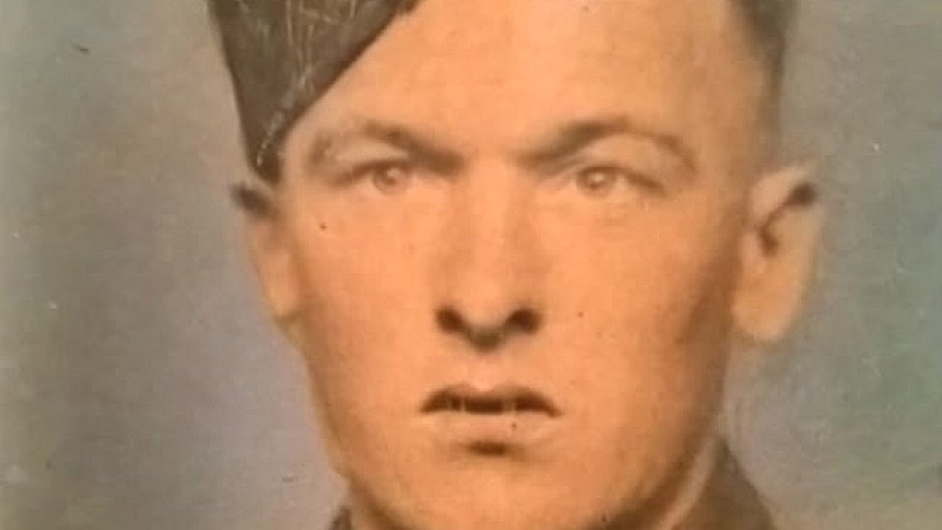
Cherished Memories
Jo Pritchard
Two soldiers from the North East have been honoured at a special service in the Netherlands after remaining unidentified for more than 70 years.
Pte Harry Vasey from Durham and L/Cpl Raymond Halliday from Stockton, were killed during Operation Market Garden in Oosterbeek in 1944.
A rededication service was held at a military cemetery in Arnhem.
Both men were part of the 1st Airborne Battalion, The Border Regiment, and were among six British servicemen killed in the military operation made famous in the film A Bridge Too Far.
https://www.itv.com/news/tyne-tees/2016-07-15/family-of-ww2-war-hero-urged-to-get-in-touch-after-his-grave-is-found-70-years-on

Slide 10
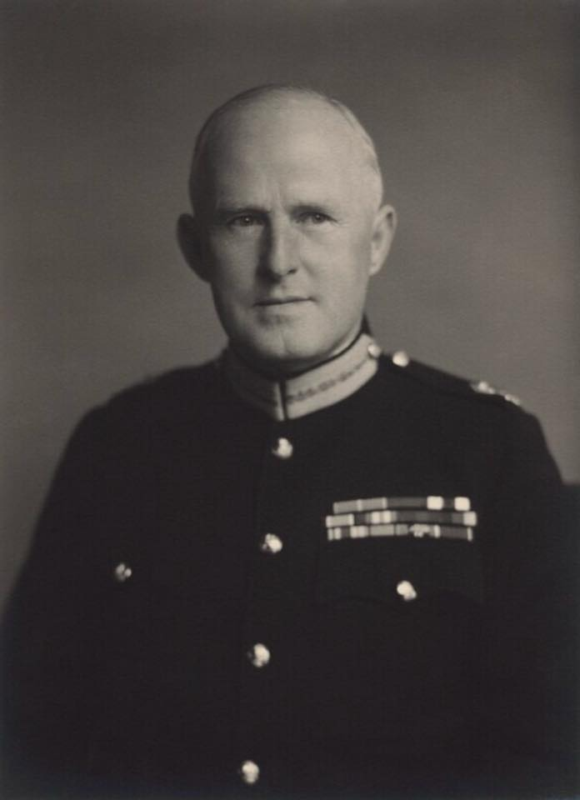
Cherished Memories
Aviva Franco
My fiancé is an army veteran – 12 years in the Army Air Corps.
My Grandfather was in the army for nearly 40 years and left as a Major General.
Attached is a photo of my Grandad – Major General Sir Peter Bednall Served 1915 – 1955

Slide 11
Cherished Memories
Julie Strain
This is a picture of my Dad when he was 17 with his Mom & Dad in Northern Ireland, it was the second world war and he was in the RAF, he got to Castle Bromwich, he was based at the aerodrome dismantling plane parts.
During this time he was working on a plane which unbeknown to him and his team still had some fuel in it, it exploded, killing one person, badly injuring another, Dad was also burnt on his face and was very lucky that he was only left with faint scaring!

Slide 13
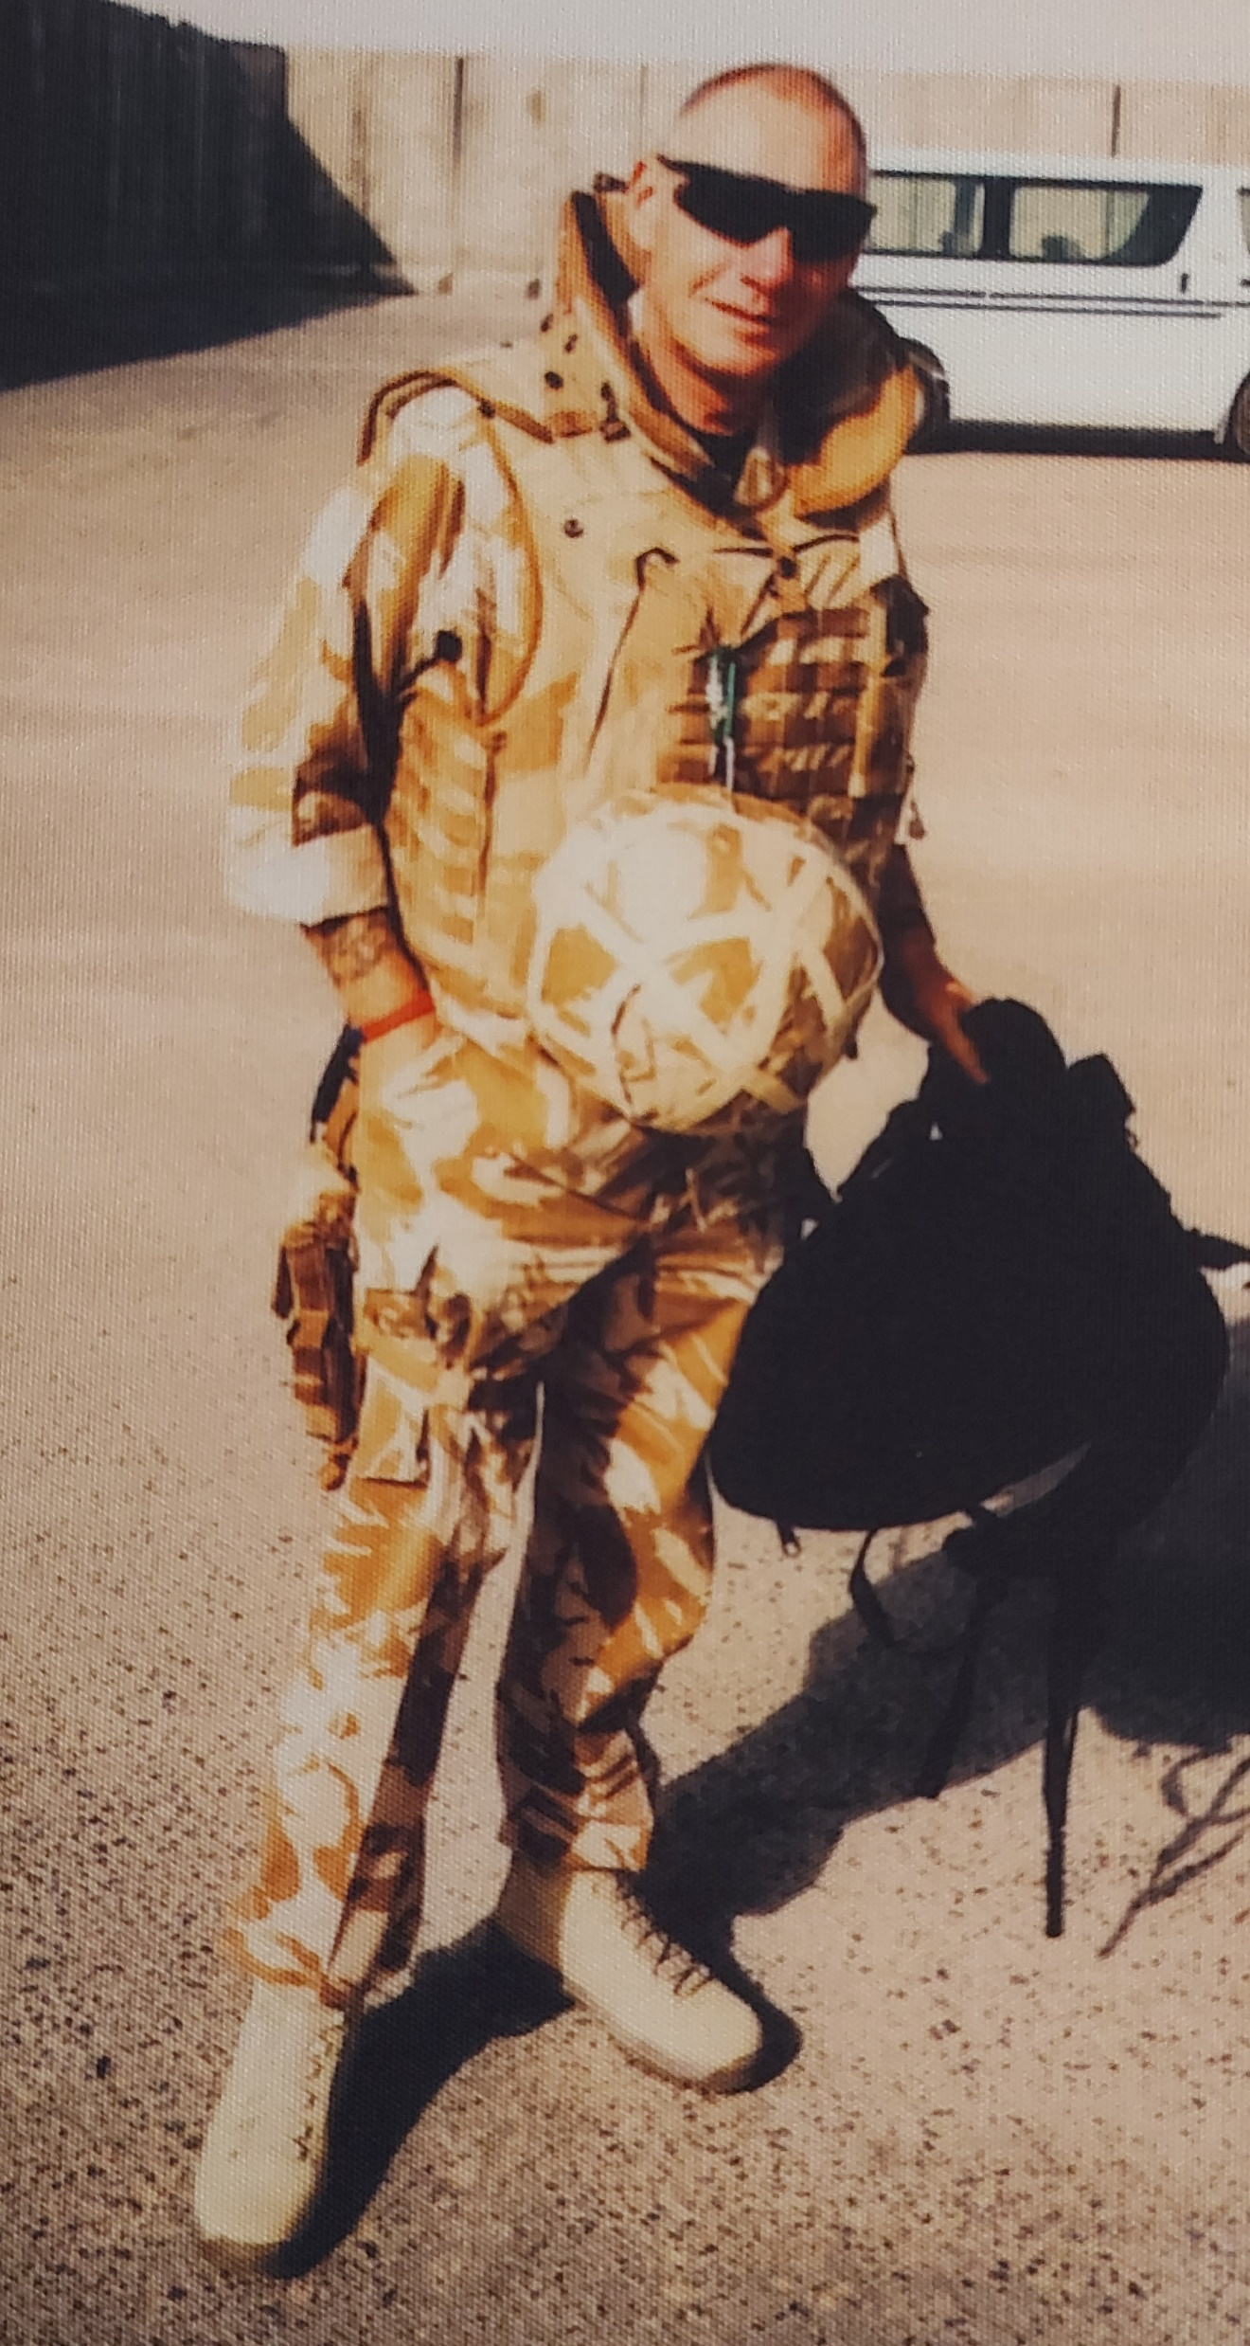
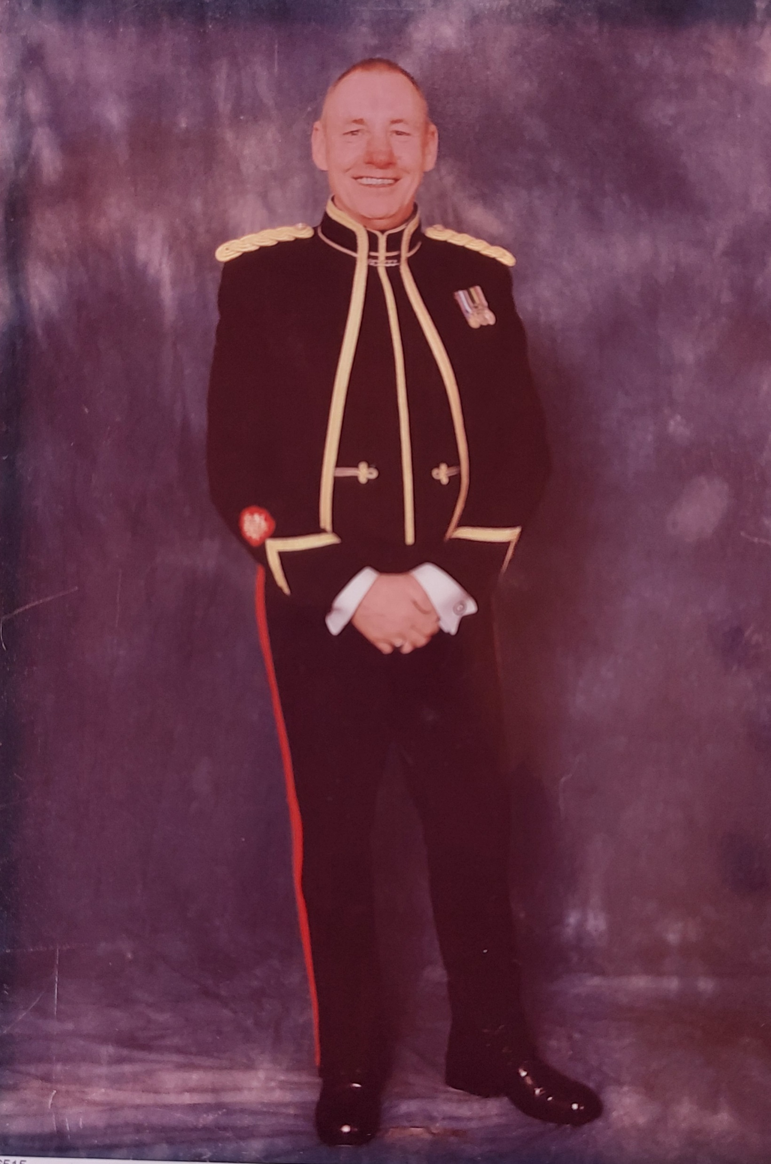
INSERT PHOTOGRAPH
Proud of Our Seetec Family
Ted Woods
INSERT PHOTOGRAPH

Slide 14
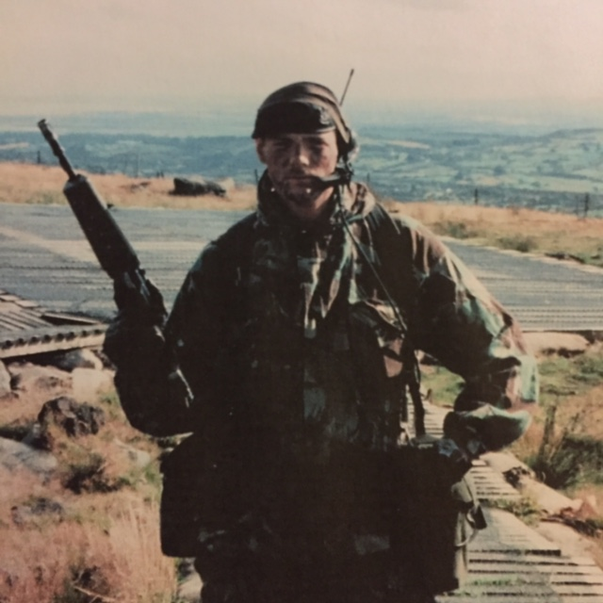
Proud of Our Seetec Family
Martin Sheppard

Slide 15
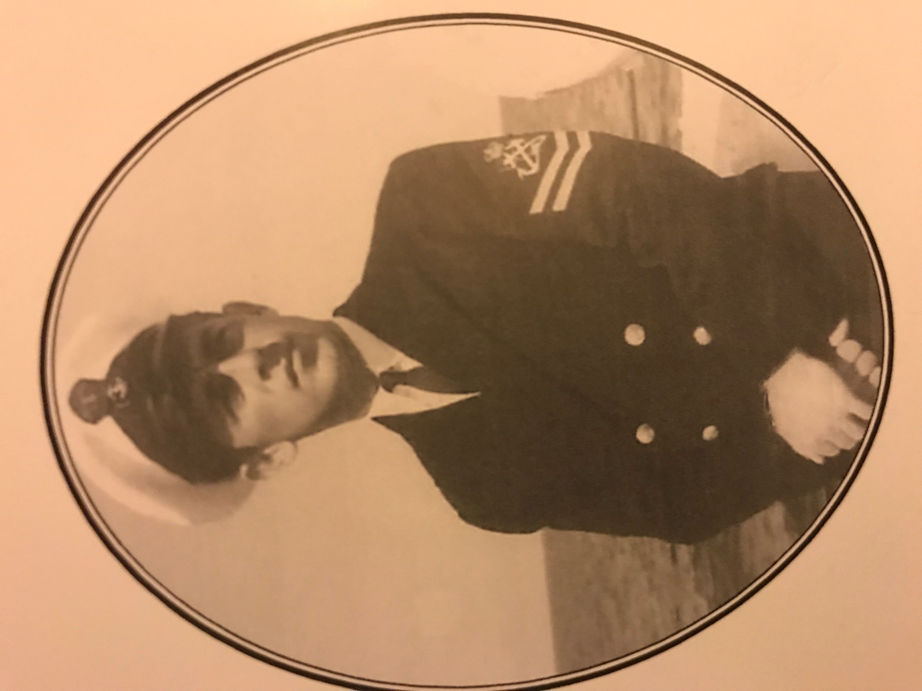
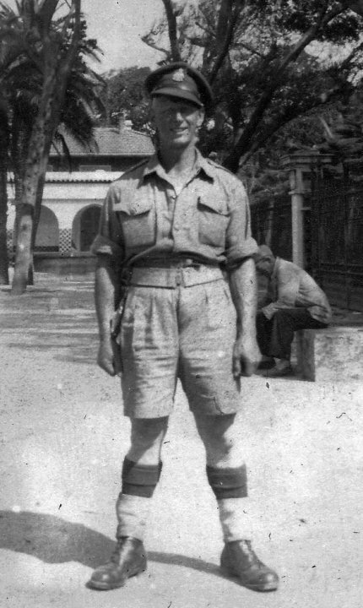
Proud of Our Seetec Family
Tony Marsden, Dad & Grandad – 3 Generations!

Slide 16
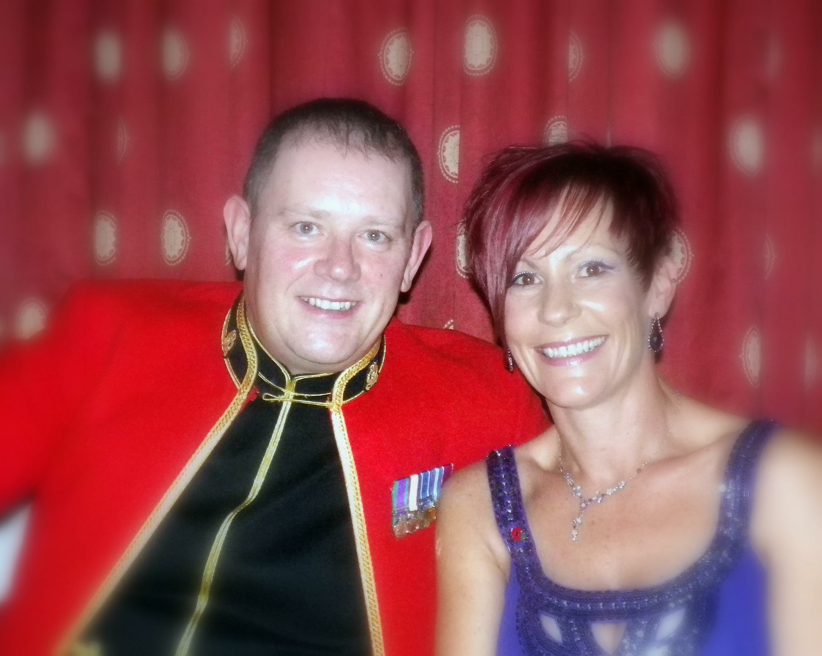
Proud of Our Seetec Family
Lindsay Murray
Attached is a pic from my husband’s dining out after 27years’ service to the army – coincidentally was the weekend of Remembrance Day, you can just see the poppy!!
It was 9 years ago but he was often away for 6 months at a time, hence perhaps where I get my resilience from?

Slide 17
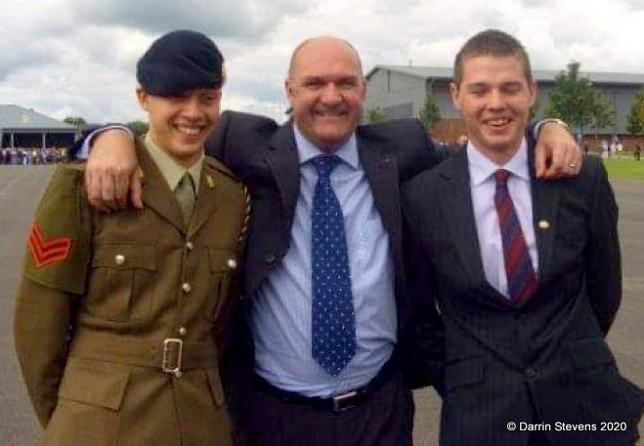
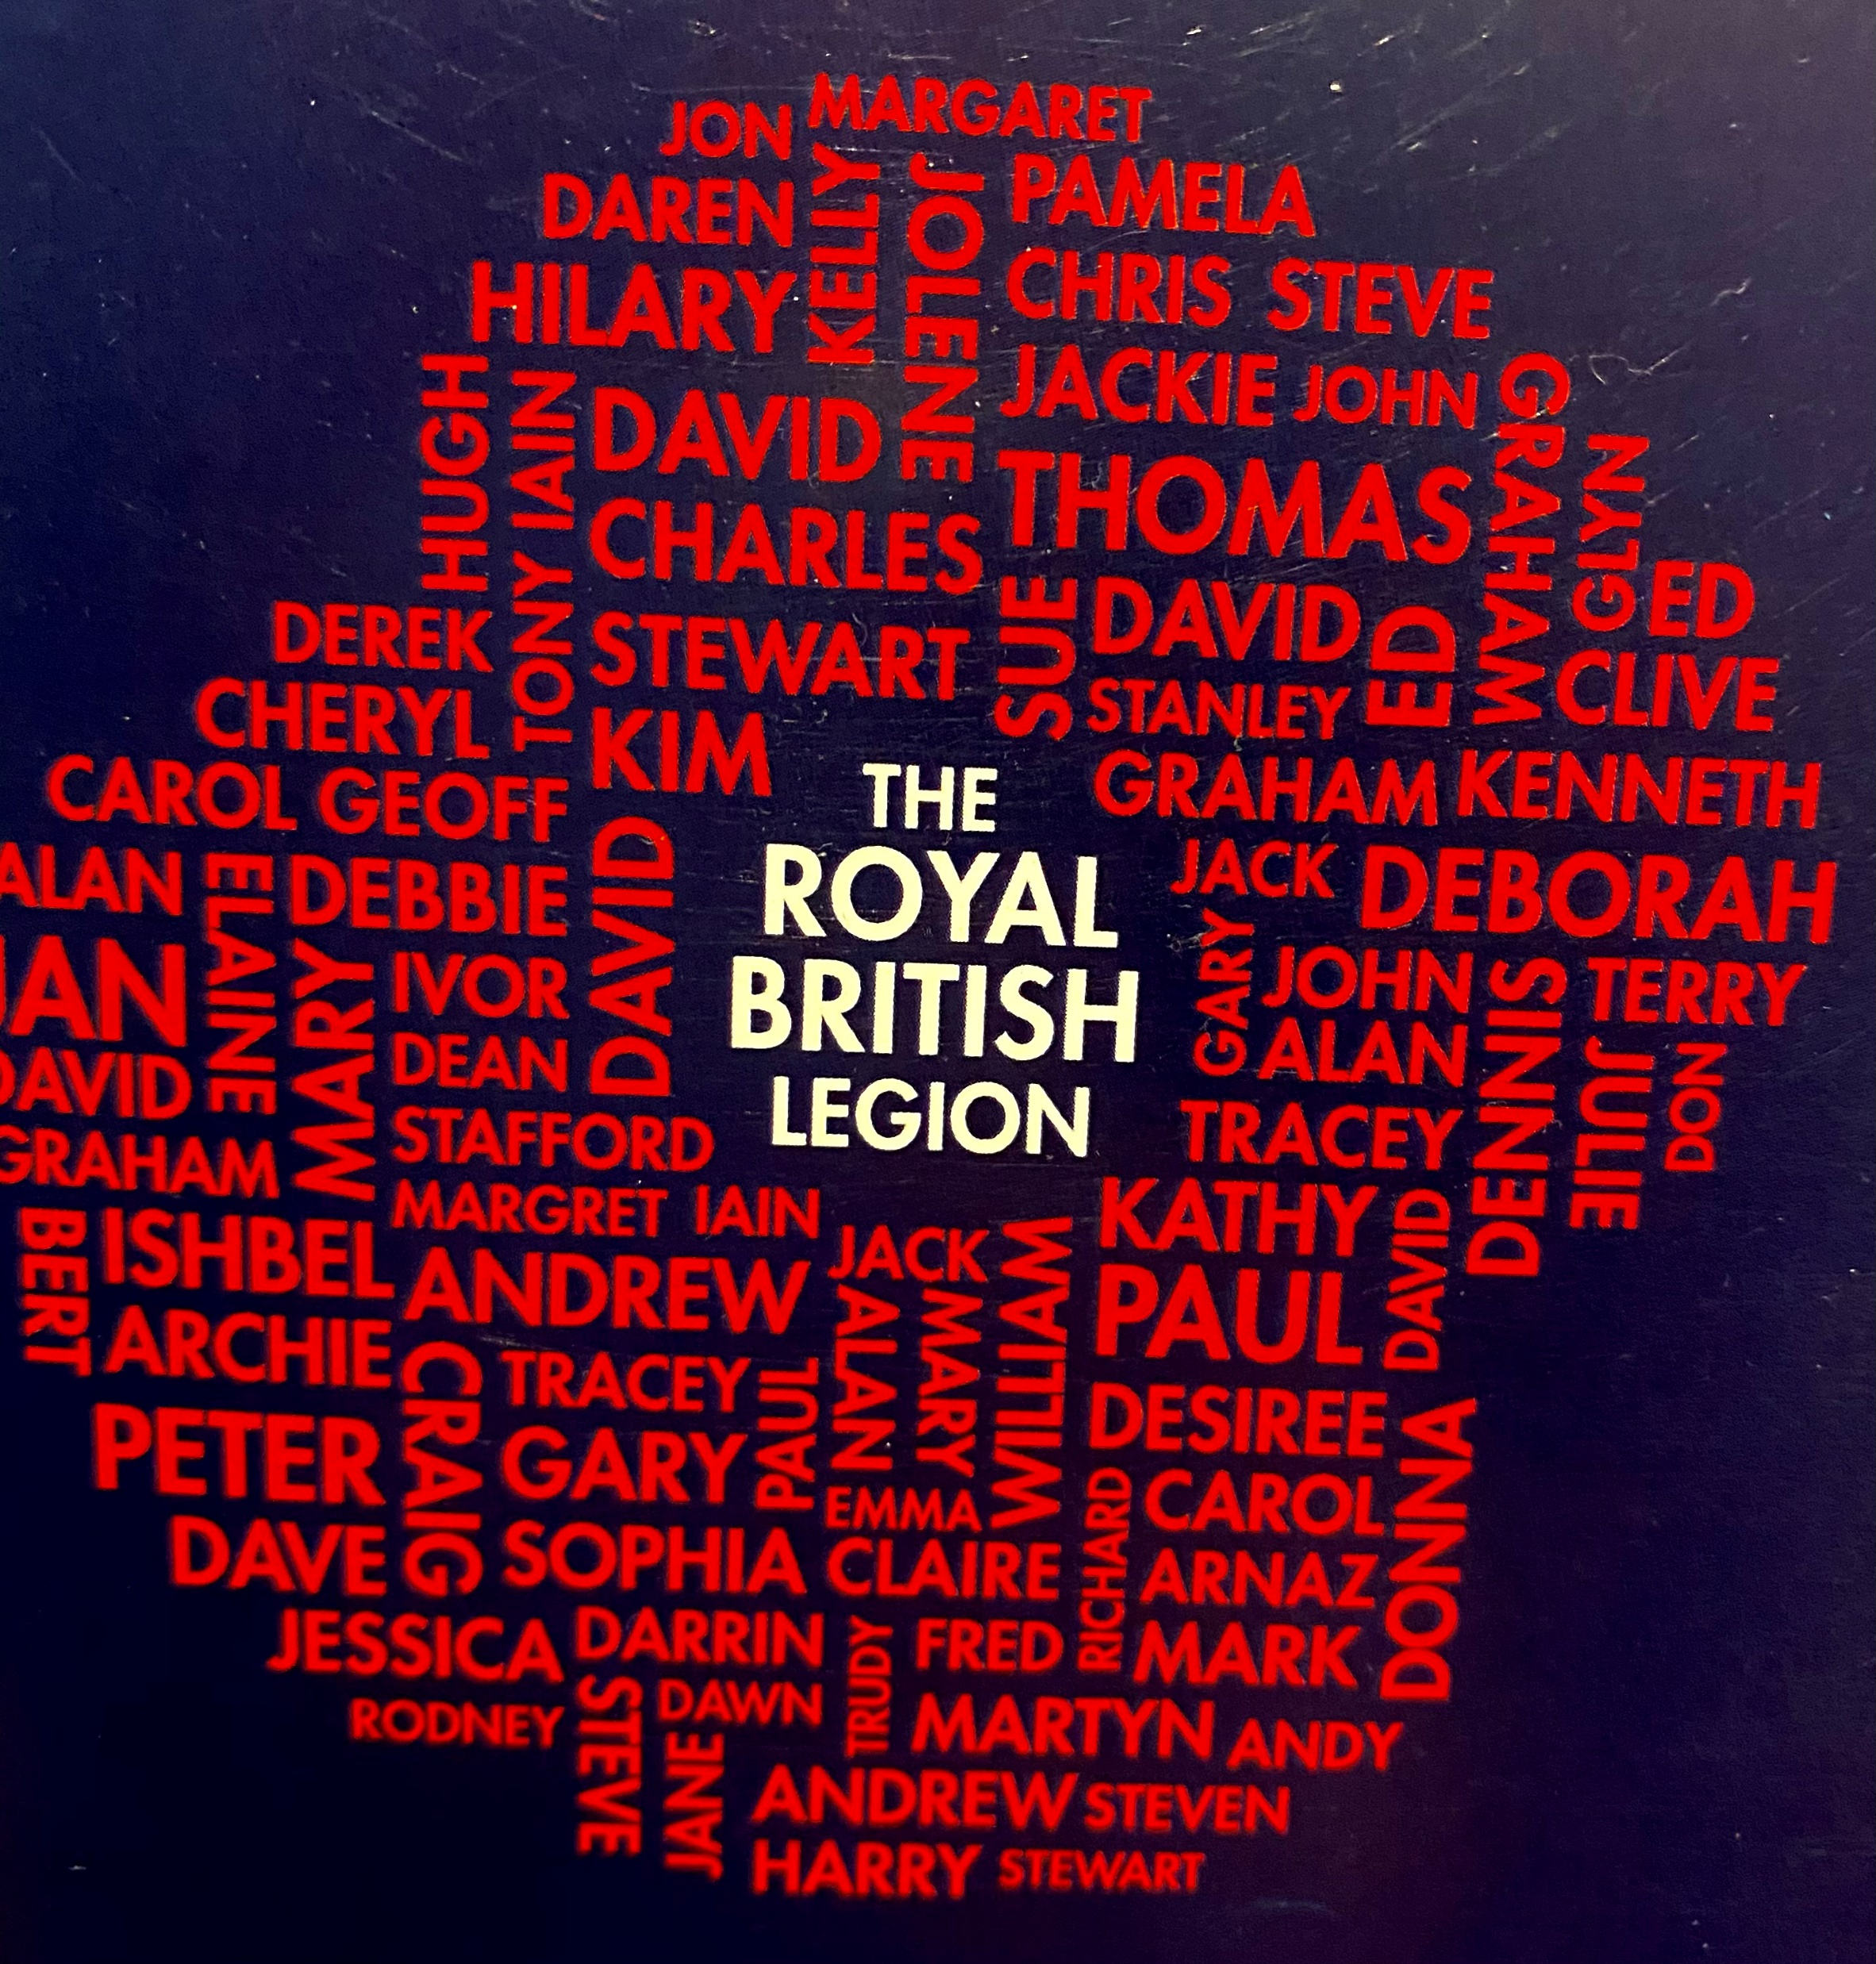
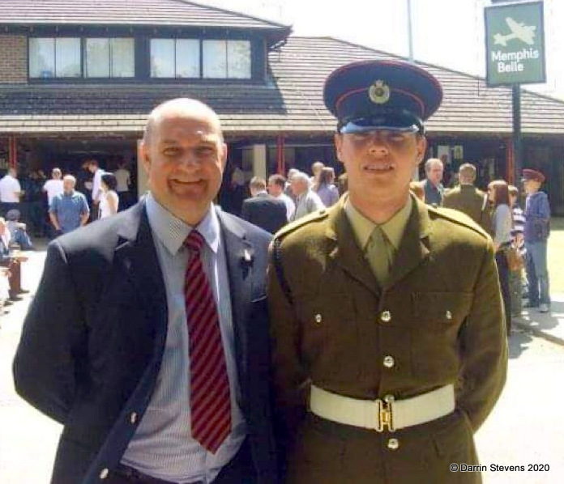
Proud of Our Seetec Family
Darrin Stevens
This is Alex and Ben with Captain Kevin Fogg Royal Signals (Dad died 10 years ago to cancer) both serving.
Ben is Royal Signals Now Sargent and Alex Royal Engineers

Slide 18
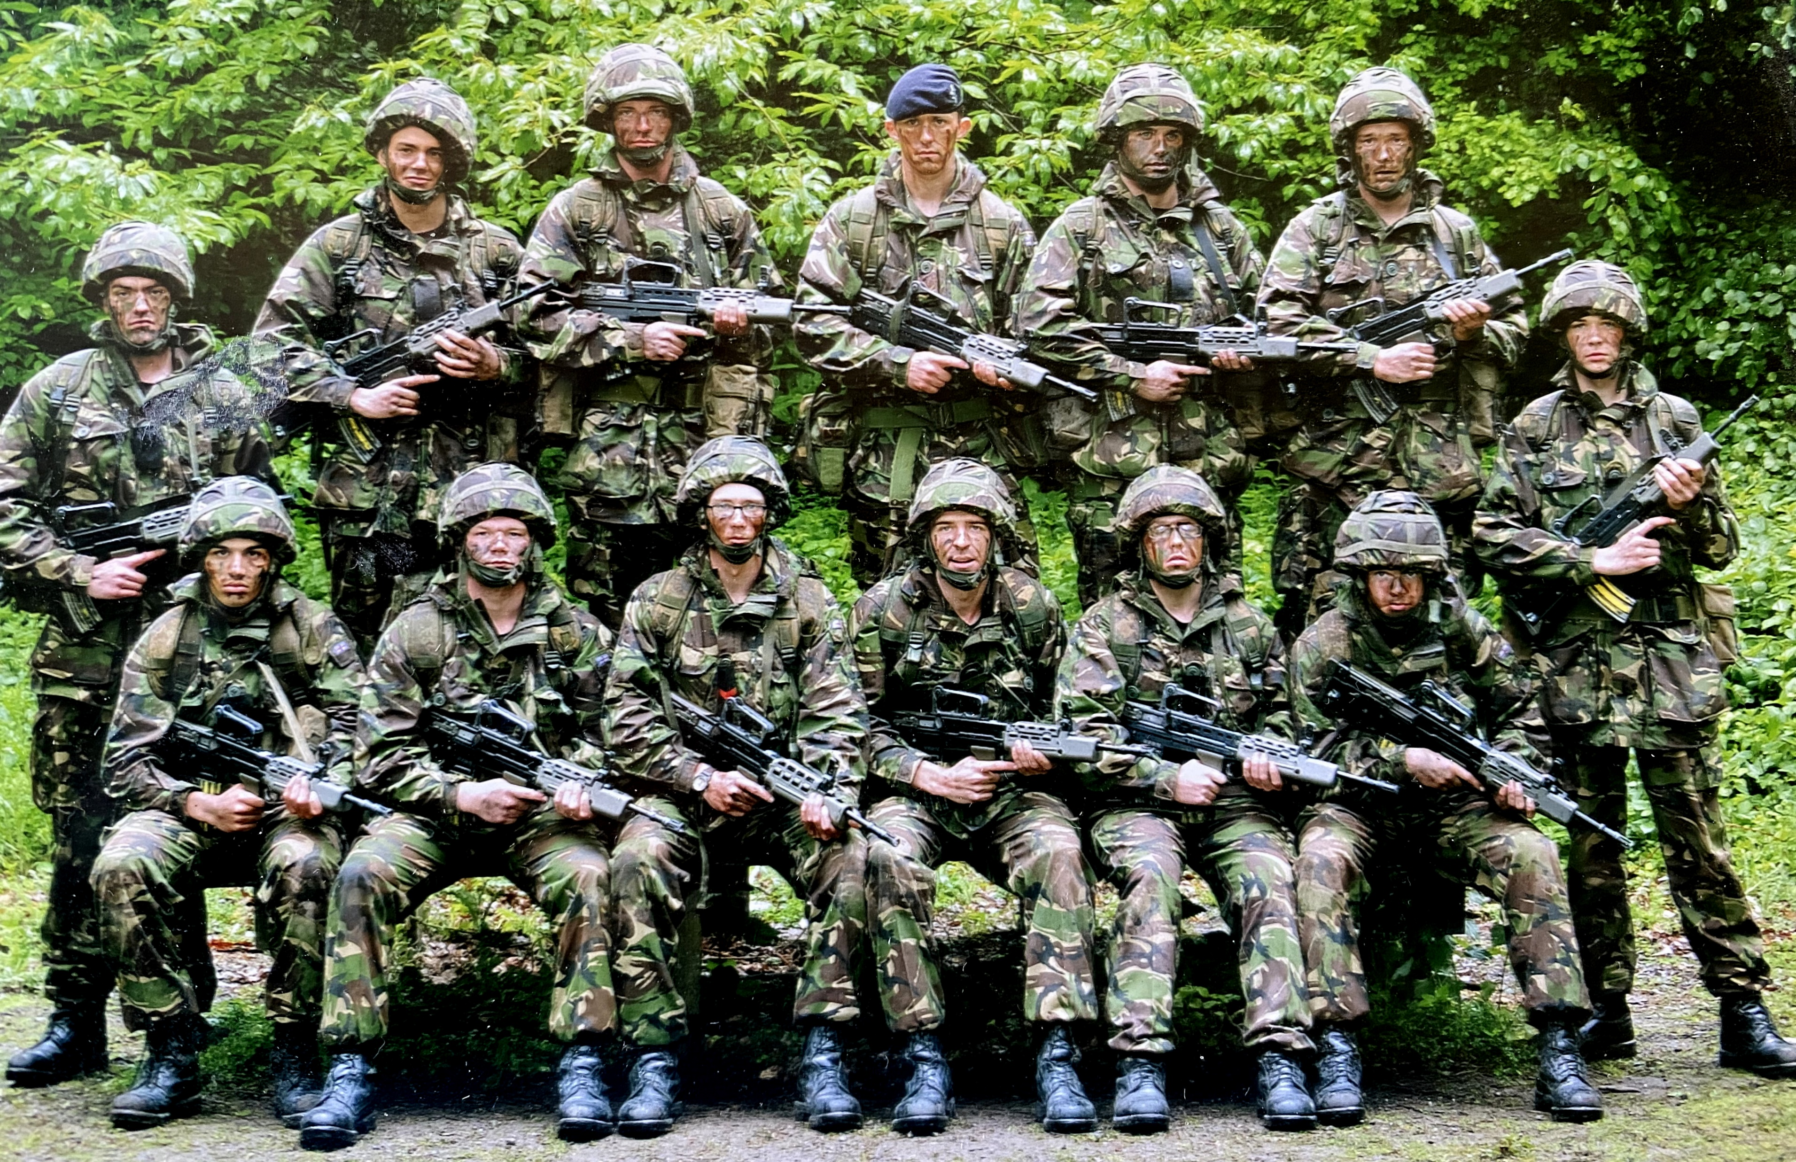
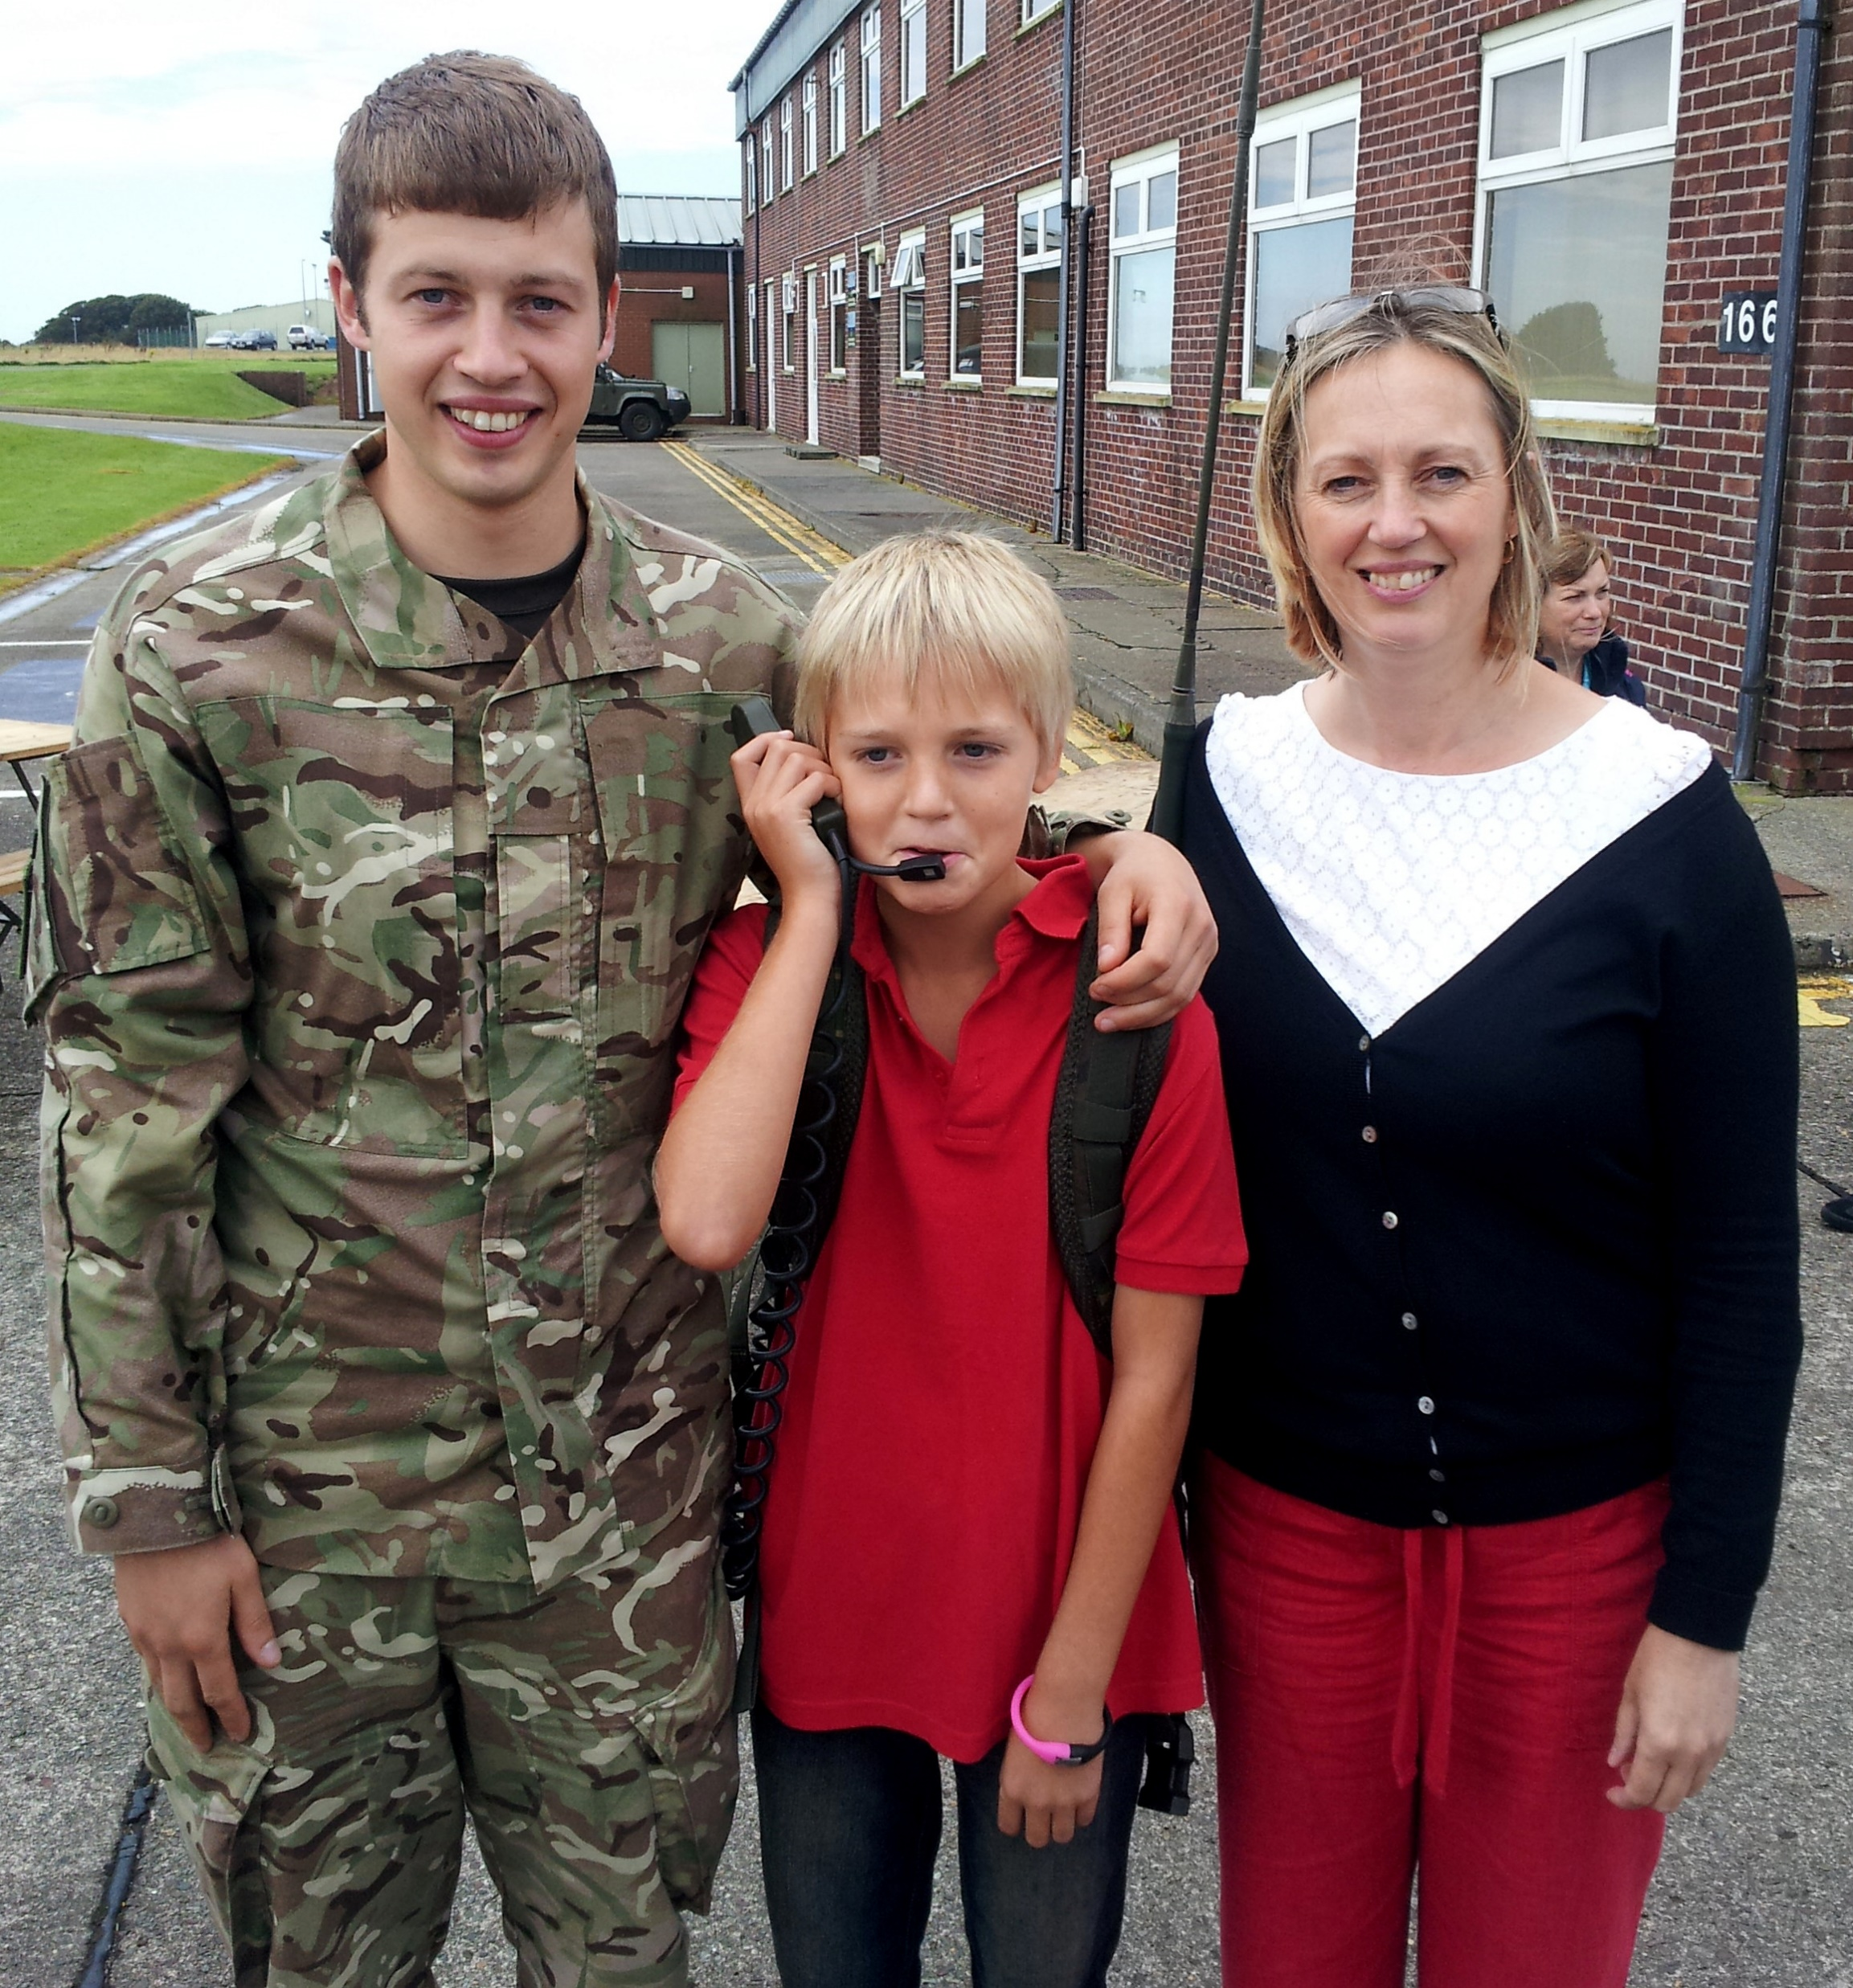
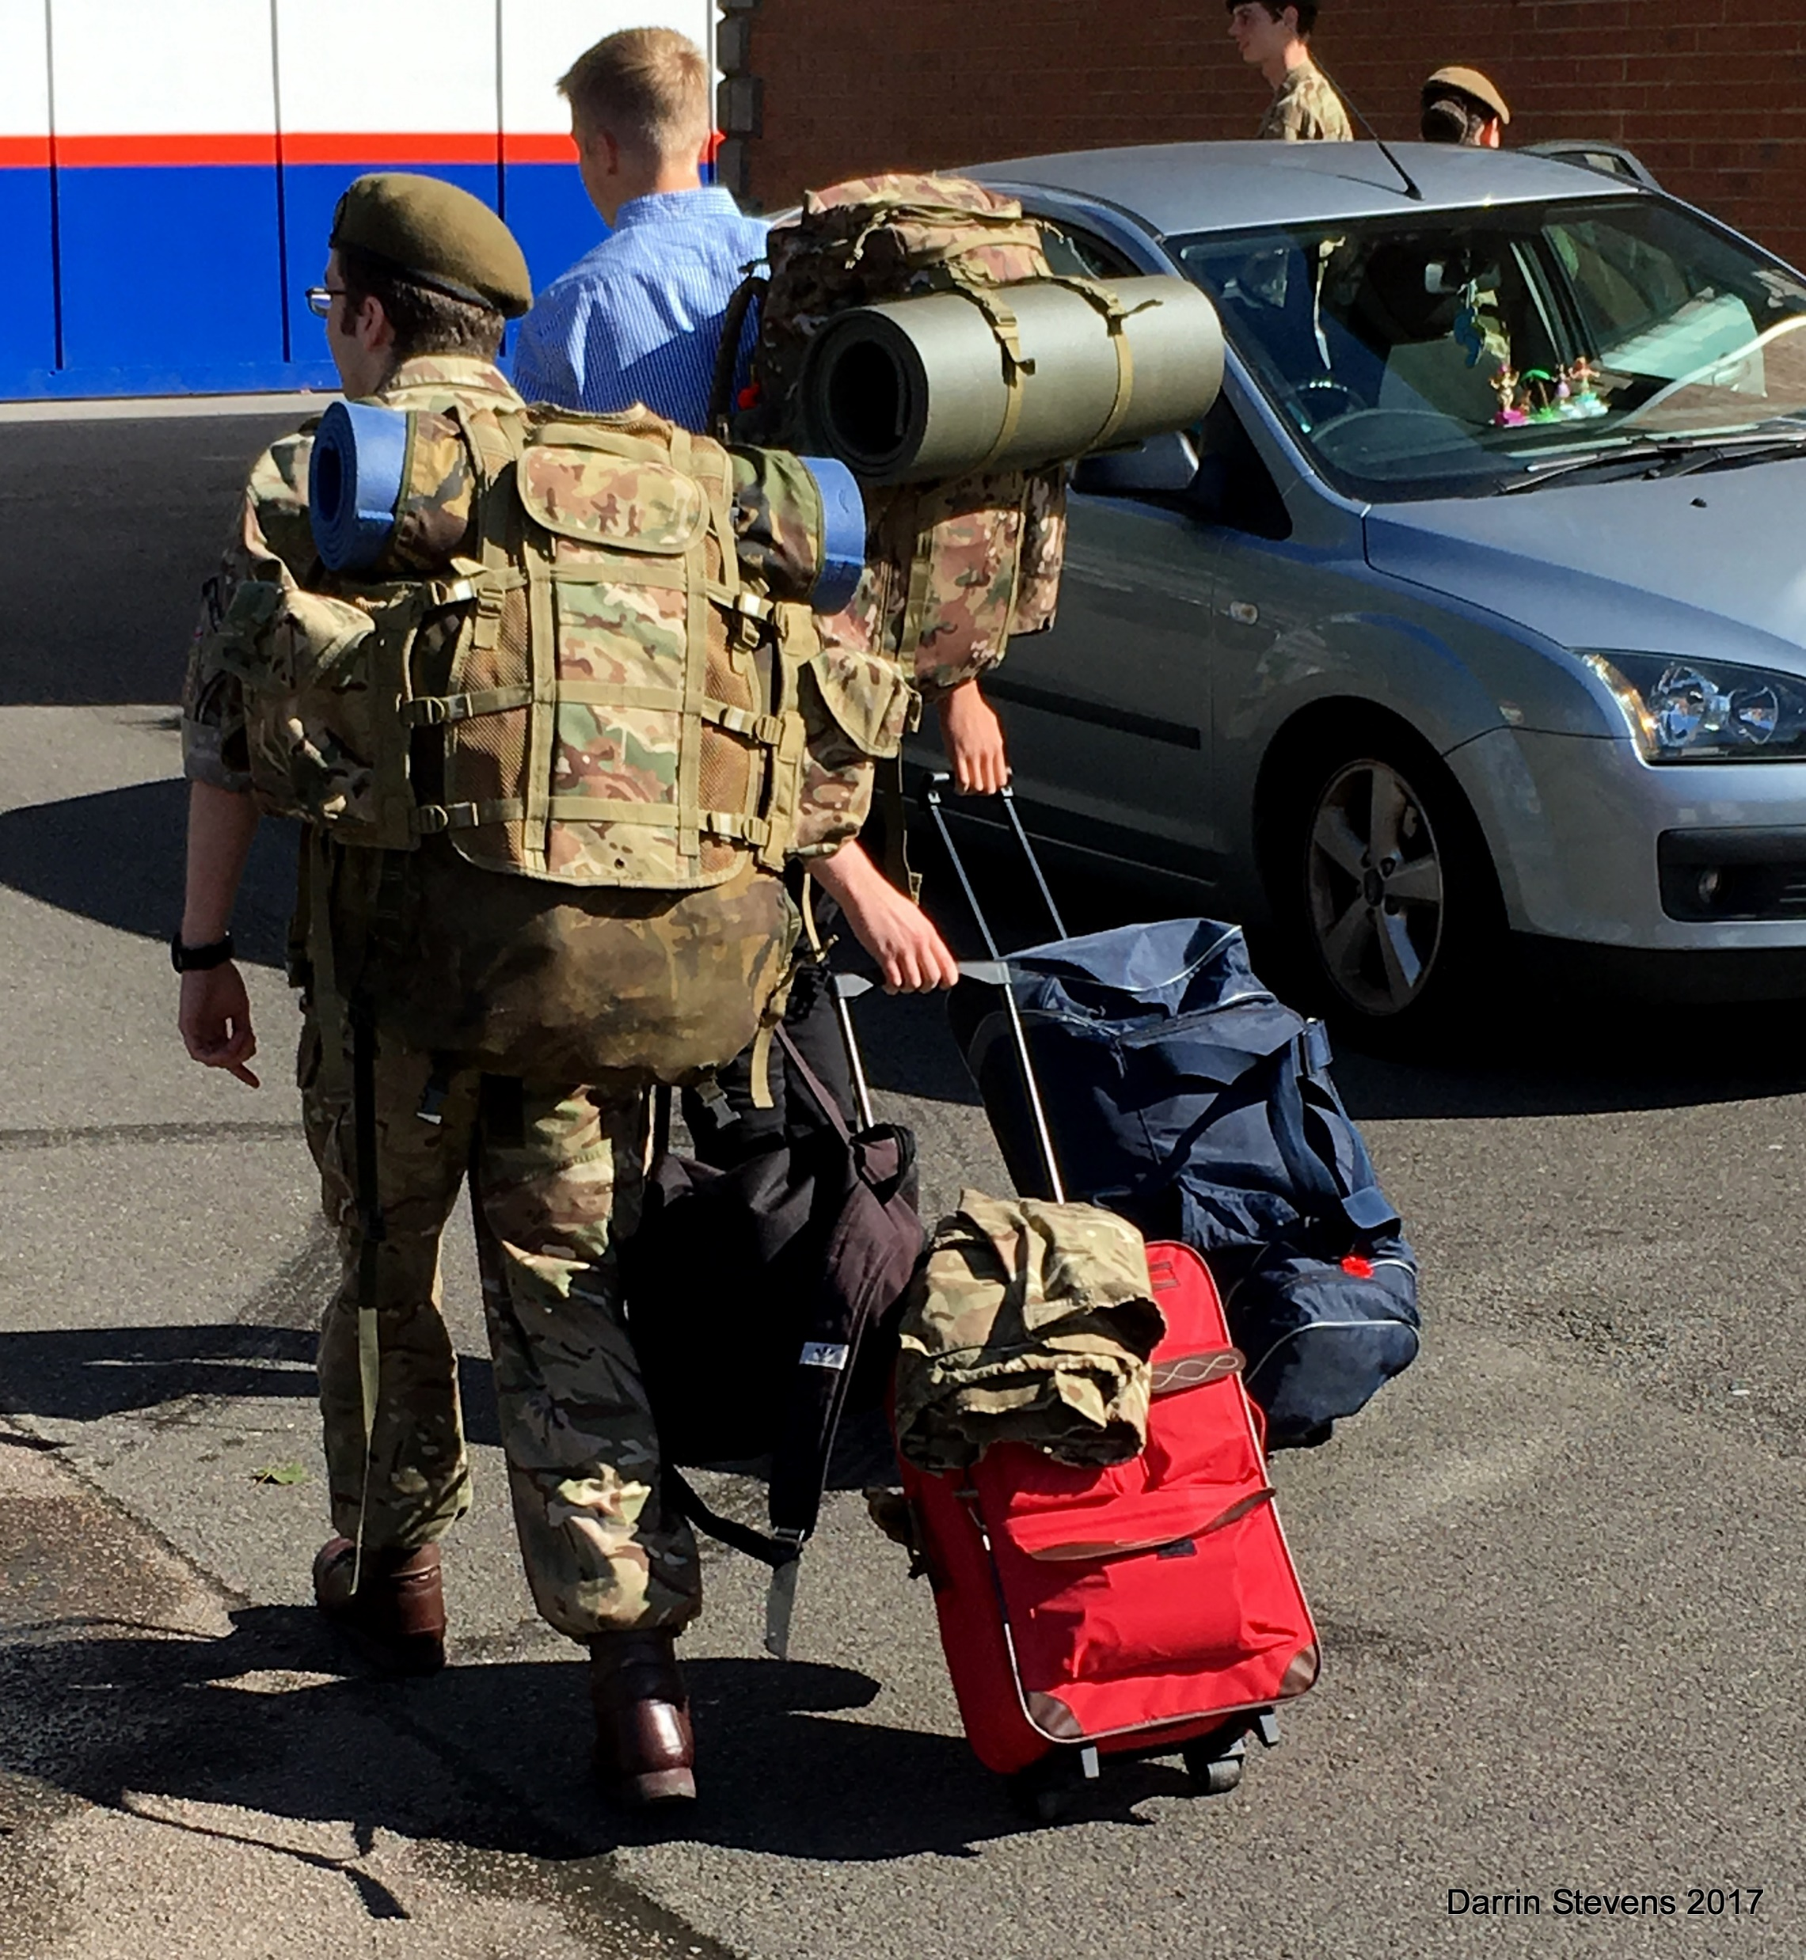
Ben and his mum before going to Afghanistan for the 2nd time and George going to camp
Proud of Our Seetec Family
Darrin Stevens

Slide 20
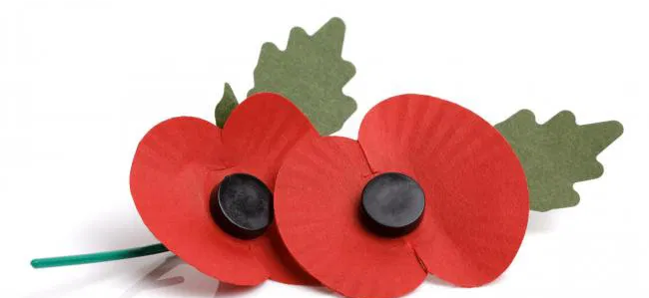
B
i
N
G
O
Poppy Appeal 2020
Sweet Hamper to Play For!
75
80
90
Other…
Notes:
Slide Name: Title

Slide 21
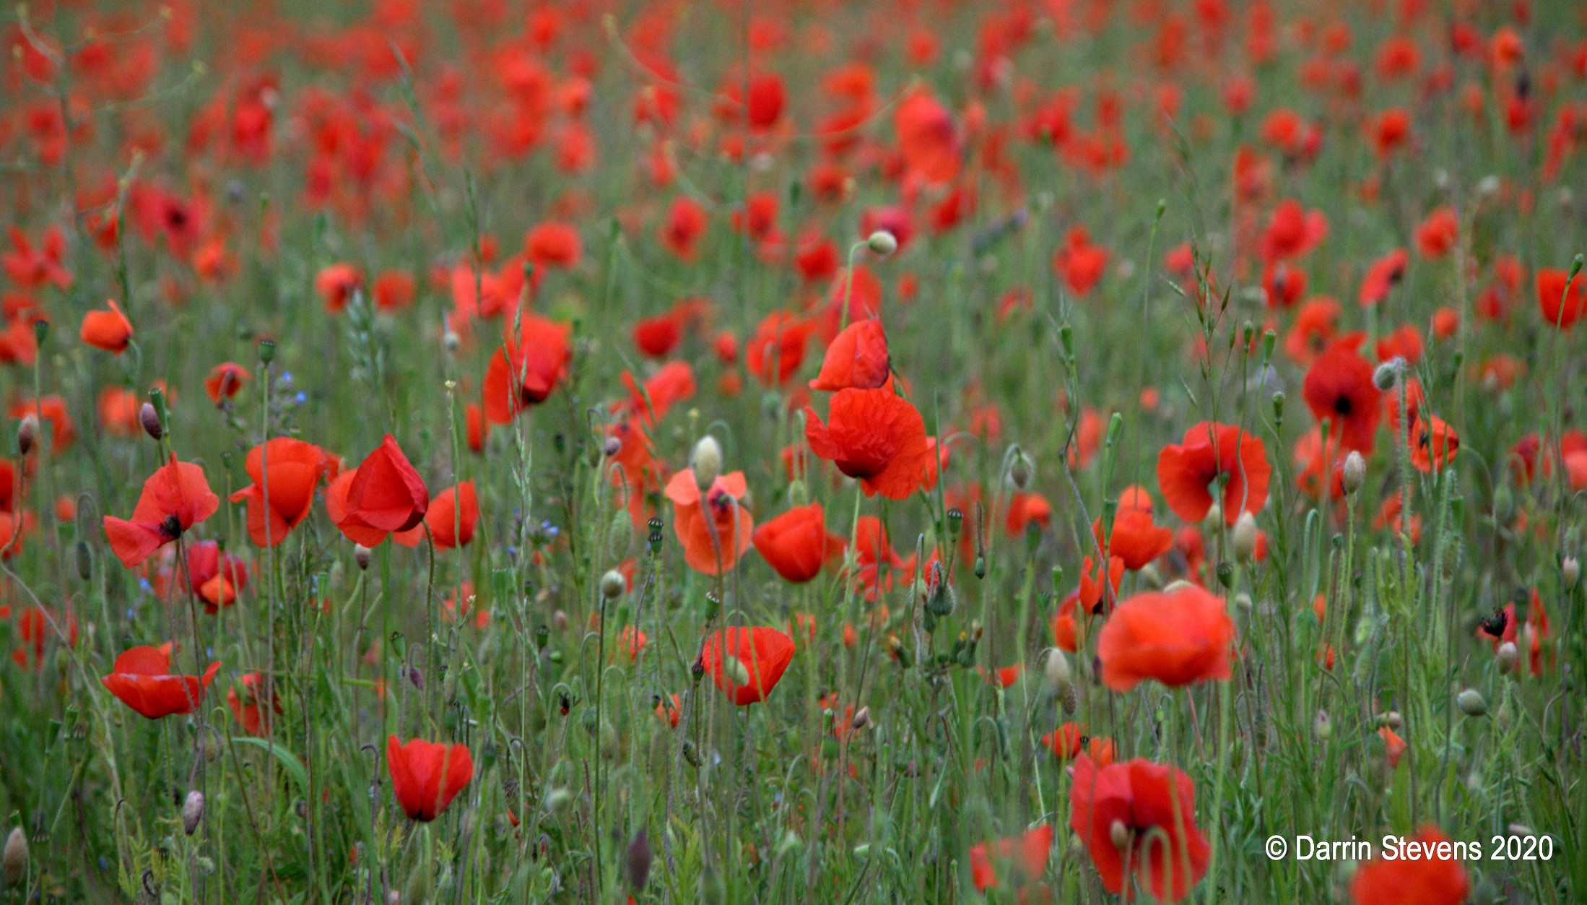
7
Notes:
Slide Name: BallEnter

Slide 22
7
Help
Home
Exit
Click on the ball to bring up the next number.
1 | 2 | 3 | 4 | 5 | 6 | 7 | 8 | 9 | 10 | 11 | 12 | 13 | 14 | 15
16 | 17 | 18 | 19 | 20 | 21 | 22 | 23 | 24 | 25 | 26 | 27 | 28 | 29 | 30
31 | 32 | 33 | 34 | 35 | 36 | 37 | 38 | 39 | 40 | 41 | 42 | 43 | 44 | 45
46 | 47 | 48 | 49 | 50 | 51 | 52 | 53 | 54 | 55 | 56 | 57 | 58 | 59 | 60
61 | 62 | 63 | 64 | 65 | 66 | 67 | 68 | 69 | 70 | 71 | 72 | 73 | 74 | 75
76 | 77 | 78 | 79 | 80 | 81 | 82 | 83 | 84 | 85 | 86 | 87 | 88 | 89 | 90
No more balls remaining. Click to re-start.
Notes:
Slide Name: BallDisplay

Slide 23
Scavenger Hunt
All to unmute and put your camera on – when return with the item shout your name and show the item – please be careful and remember health & safety!!
1 Remote control
2 Biscuit
3 Highlighter Pen
4 Bottle of Water……NOT Gin ☺
5 Framed photo of your line manager
6 Really no photo?....ha ha photo of a family member
7 Clock
8 Umbrella
9 Slippers
Box of chocolates for the winner!!

Slide 24
Raffle
2 bottles of Champagne:
1 bottle of Gin:
1 Poppy Canvas:
1 bottle of wine:
1 bottle of wine:

Slide 25
Poppy Bear
Need some words here

Slide 26
Our Very Own “Poppy”
Happy Birthday to Tina Chummun on 11/11/2020

Slide 27
Target
Thank you!

Slide 29
Thank you all for your support!
And for your time this afternoon, let us all make some Proud Seetec Family Memories over the next few weeks for us to share at the end of the month.
Send any memories made to me so I can make our very first memory collage to share on our next get together. Lets make some positive happy times to share and makes us all smile.
Lets all keep close and talk, pick up the phone/Skype and now Teams and talk ☺
Have a restful weekend all and stay safe.
Notes:
Memories, sewing you have completed, walking the dog, kicking leaves, favourite puzzle ,cakes, photo you had forgotten about zoom pictures of family gatherings, anything that has made you smile

