Slide 1
maximising potential through study programmes
Alin (adult learning improvement network)
.
Contact: INFO@ alin.org.uk

Slide 2
MAXIMISING POTENTIAL THROUGH STUDY
PROGRAMMES
Management of work experience and the better embedding of maths and English
Raising the profile of Calculation and Communication
Increasing the focus and importance of Employability and Social Action
Now into its 4th year supporting providers in developing and managing 16-19 Study programmes to improve the quality and delivery.

Slide 3

TECHNICAL ROUTE FLYERS
Over 55 produced promoting maths and English skills
All 15 technical routes with practical tasks in job roles
Links to GCSE maths and English
Links to new Functional Skills maths and English
Notes:
Share Flyers with group

Slide 4
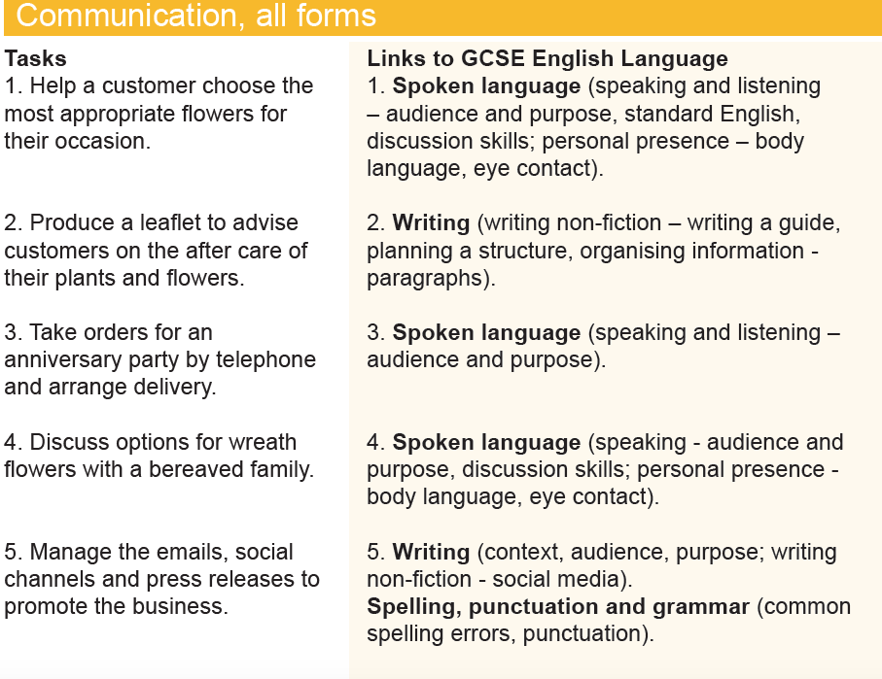
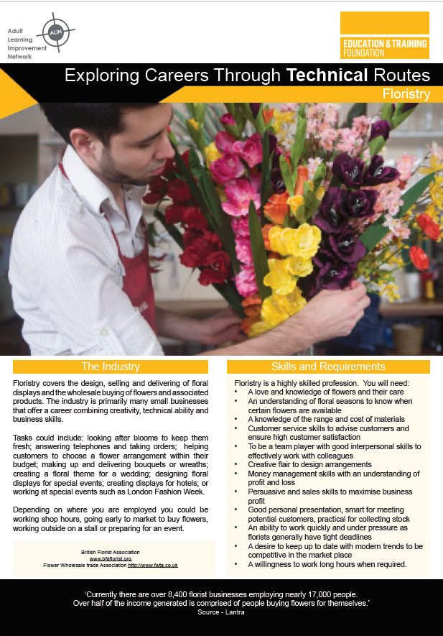
Floristry
Level 3

Slide 5
OCCUPATIONAL ROUTE FLYERS
Level 2
Barber
Level 1
Arable Farming
Hospitality team member
Childcare
Woodland skills
Notes:
Share Flyers with group

Slide 6
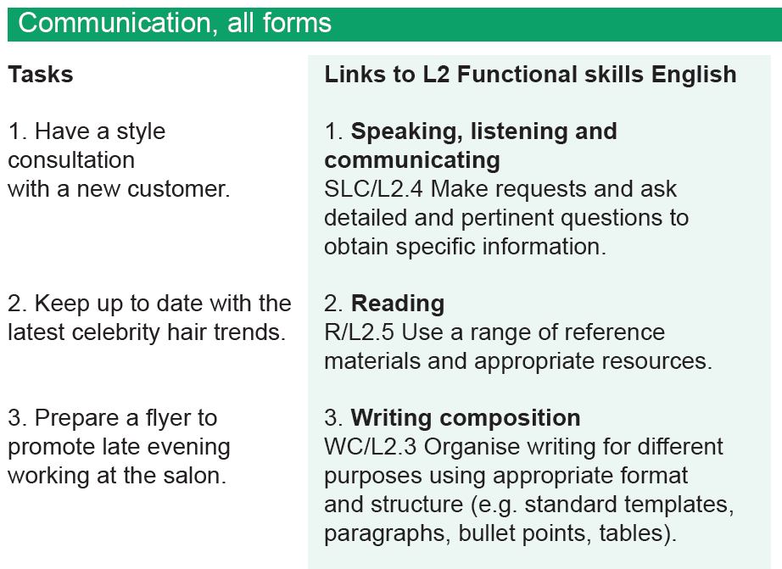
Barber
Level 2

Slide 7
Request from London College Principal
Technical route Hospitality and Catering
Algebra
Specifically to look at one aspect of maths
Notes:
There have been requests from providers to be involved and create one for each course that they run, vocational and academic.

Slide 8
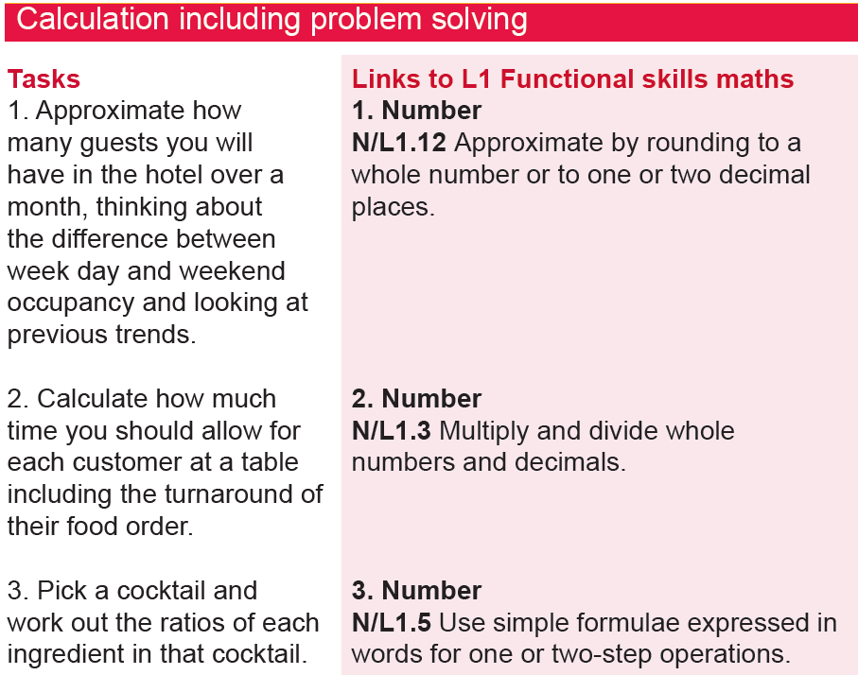
Hospitality Team Member
Level 1

Slide 9
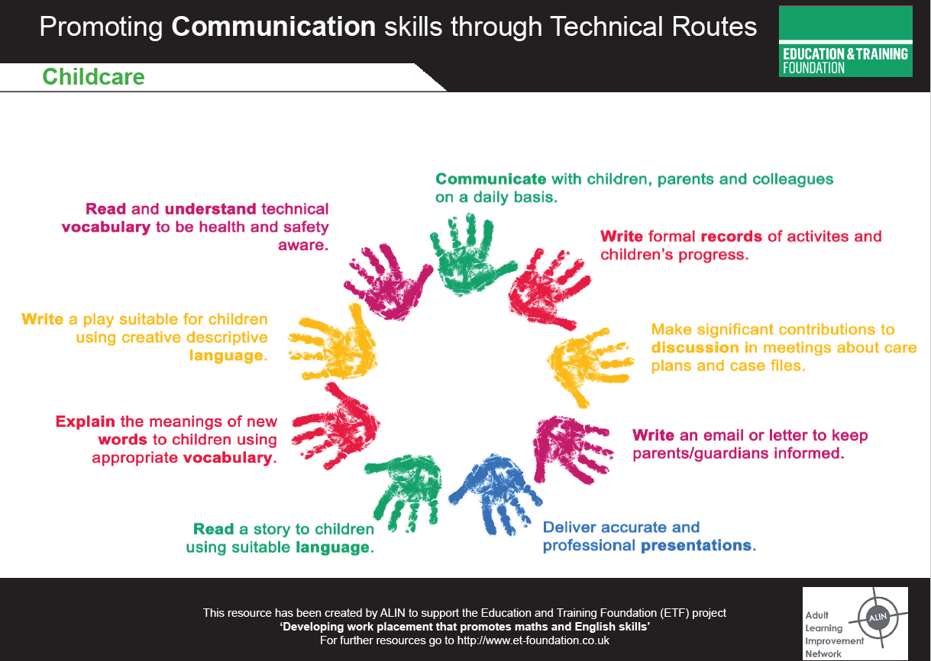
ANIMATIONS – TO REACH A WIDER AUDIENCE
Promote communication and
calculation in job roles.
Limited to one and a half
minutes for maximum impact.
15 completed.
5 are currently available on the
ETF Excellence Gateway.
Click below to access video:
https://learningvideos.co.uk/wp-content/uploads/2018/05/Childcare-NEW.mp4.mp4

Slide 10
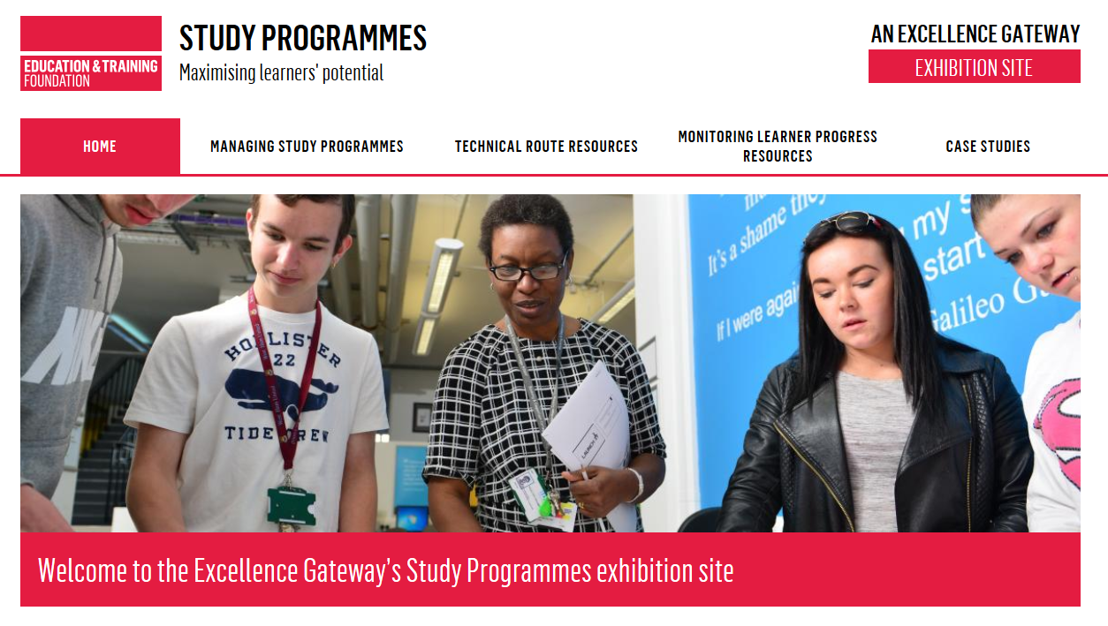
BRAND NEW STUDY PROGRAMME EXHIBITION SITE LAUNCHED DECEMBER 2018!

Slide 11
BRAND NEW STUDY PROGRAMME EXHIBITION SITE LAUNCHED DECEMBER 2018!
The Excellence Gateway Exhibition Site, launched by the ETF brings together all the key information and resources to help post-16 providers of study programmes in one place.
Resources include reports, training materials, presentations, flyers, videos, posters, and case studies from study programmes.
https://studyprogrammes.excellencegateway.org.uk/

