Slide 1
Workforce Survey 2017
August 2017

Slide 2
[q8] Relative to your overall cost base, what impact have the following statutory changes had on your business? NATIONAL LIVING WAGE
50% reporting increase in costs
[q8] Relative to your overall cost base, what impact have the following statutory changes had on your business?
Workforce Survey 2017
BASE: (Total: N = 1403)

Slide 3
[q8] Relative to your overall cost base, what impact have the following statutory changes had on your business? APPRENTICESHIP LEVY
20% reporting increase in costs
[q8] Relative to your overall cost base, what impact have the following statutory changes had on your business?
Workforce Survey 2017
BASE: (Total: N = 1351)

Slide 4
[q8] Relative to your overall cost base, what impact have the following statutory changes had on your business? IMMIGRATION SKILLS CHARGE
8% reporting increase in costs
[q8] Relative to your overall cost base, what impact have the following statutory changes had on your business?
Workforce Survey 2017
BASE: (Total: N = 1346)

Slide 5
[q8] Relative to your overall cost base, what impact have the following statutory changes had on your business? PENSIONS AUTO-ENROLMENT
75% reporting increase in costs
[q8] Relative to your overall cost base, what impact have the following statutory changes had on your business?
Workforce Survey 2017
BASE: (Total: N = 1386)

Slide 6
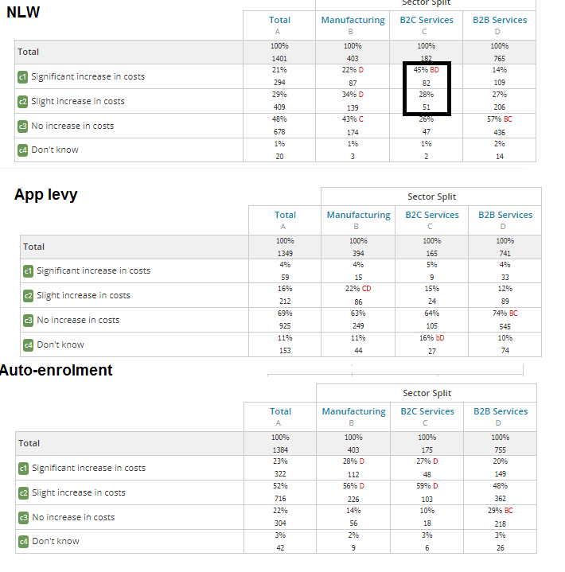
Costs by sector
73% of B2C reporting increase in costs compared to 41% of B2B
[q8] Relative to your overall cost base, what impact have the following statutory changes had on your business?
Workforce Survey 2017
BASE: (Total: N = 1386)

Slide 7
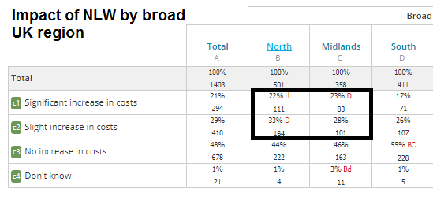
55% and 51% of respondents in North and Midlands reporting increase in costs, respectively.
43% of respondents in the South reporting increase in costs.
[q8] Relative to your overall cost base, what impact have the following statutory changes had on your business?
Workforce Survey 2017
BASE: (Total: N = 1386)

Slide 8
[q10] What ways, if any, would your business respond to such increases in the National Living Wage over the next 3 years?
[q10] What ways, if any, would your business respond to such increases in the National Living Wage over the next 3 years?
Workforce Survey 2017
BASE: (Total: N = 1387)

Slide 9
[q11] Does your firm’s pay bill exceed £3m?
[q11] Does your firm’s pay bill exceed £3m?
Workforce Survey 2017
BASE: (Total: N = 1427)

Slide 10
[q12] In the last 12 months, has your business recruited apprentices?
[q12] In the last 12 months, has your business recruited apprentices?
Workforce Survey 2017
BASE: (Total: N = 1427)

Slide 11
[q14] Do you expect to recover the Apprenticeship Levy amount spent by your company? I.e. by training sufficient apprentices to recoup the amount levied
Workforce Survey 2017
BASE: (Do you expect to recover the Apprenticeship Levy amount spent by your company? I.e. by training sufficient apprentices to recoup the amount levied: N = 137)

Slide 12
[q15] What changes, if any, will your business make as a direct response to the introduction of the Apprenticeship Levy?
[q15] What changes, if any, will your business make as a direct response to the introduction of the Apprenticeship Levy?
Workforce Survey 2017
BASE: (Total: N = 1321)

Slide 13
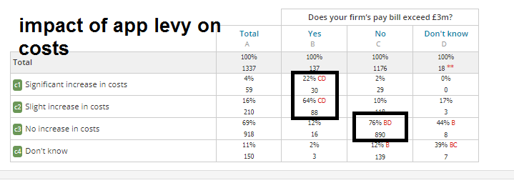
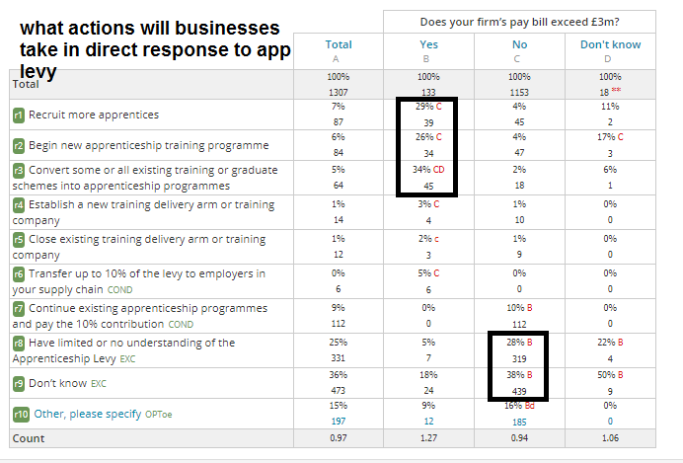
[q8] Relative to your overall cost base, what impact have the following statutory changes had on your business?
Workforce Survey 2017
BASE: (Total: N = 1386)

Slide 14
[q16] Over the past 12 months, has your business faced skills or labour shortages?
[q16] Over the past 12 months, has your business faced skills or labour shortages?
Workforce Survey 2017
BASE: (Total: N = 1411)

Slide 15
[q17] Over the past 12 months, how has your business sought to address skills or labour shortages shortages?
[q17] Over the past 12 months, how has your business sought to address skills or labour shortages shortages?
Workforce Survey 2017
BASE: (Total: N = 676)

Slide 16
[q18] Which of the following approaches does your business typically take to fill job vacancies?
[q18] Which of the following approaches does your business typically take to fill job vacancies?
Workforce Survey 2017
BASE: (Total: N = 1395)

Slide 17
[q19] Approximately what percentage of job applications for roles within your company come from the EU or rest of the world?
[q19] Approximately what percentage of job applications for roles within your company come from the EU or rest of the world?
Workforce Survey 2017
BASE: (EU nationals (i.e. non-UK): N = 1354;Non-EU nationals (i.e. rest of the world): N = 1232)

Slide 18
[q20a] Approximately what percentage of your organisation's employees are from other EU countries (i.e. non-UK)?
[q20a] Approximately what percentage of your organisation's employees are from other EU countries (i.e. non-UK)?
Workforce Survey 2017
BASE: (Total: N = 1387)

Slide 19
[q20b] Approximately what percentage of your organisation's employees are from outside the EU (i.e. rest of the world)?
[q20b] Approximately what percentage of your organisation's employees are from outside the EU (i.e. rest of the world)?
Workforce Survey 2017
BASE: (Total: N = 1379)

Slide 20
[q21] How would you describe the skill levels of the non-UK employees in your business?
[q21] How would you describe the skill levels of the non-UK employees in your business?
Workforce Survey 2017
BASE: (Total: N = 608)

Slide 21
[q22] What impact, if any, would any future restriction on the rights of EU nationals to work in the UK to have on your business?
[q22] What impact, if any, would any future restriction on the rights of EU nationals to work in the UK to have on your business?
Workforce Survey 2017
BASE: (Total: N = 1376)

Slide 22
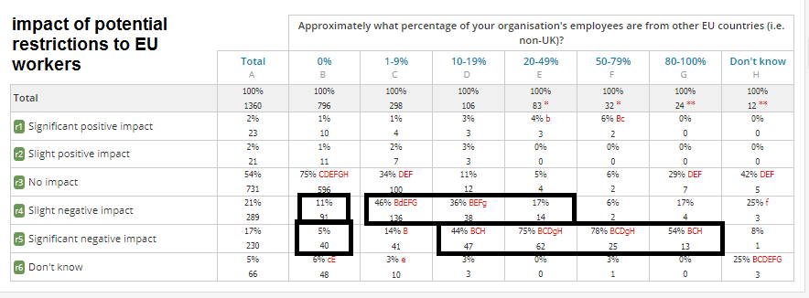
[q22] What impact, if any, would any future restriction on the rights of EU nationals to work in the UK to have on your business?
[q23] How would your business respond, if at all, to any potential future restriction on the rights of EU nationals to work in the UK?
Workforce Survey 2017
BASE: (Total: N = 1354)

Slide 23
[q23] How would your business respond, if at all, to any potential future restriction on the rights of EU nationals to work in the UK?
[q23] How would your business respond, if at all, to any potential future restriction on the rights of EU nationals to work in the UK?
Workforce Survey 2017
BASE: (Total: N = 1354)

Slide 24
[q24] Approximately what is the average age of employees in your workforce?
[q24] Approximately what is the average age of employees in your workforce?
Workforce Survey 2017
BASE: (Total: N = 1367)

Slide 25
[q25] Considering the past five years, has there been a change in the number of staff in your business working flexibly (e.g. from home or other remote locations) during work days?
40% of respondents report an increase in the number of staff working flexibly
[q25] Considering the past five years, has there been a change in the number of staff in your business working flexibly (e.g. from home or other remote locations) during work days?
Workforce Survey 2017
BASE: (Total: N = 1356)

Slide 26
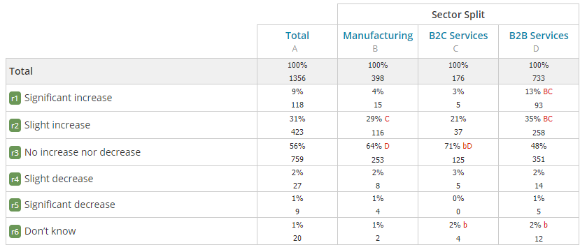
[q25] Considering the past five years, has there been a change in the number of staff in your business working flexibly (e.g. from home or other remote locations) during work days?
48% of B2B firms report an increase in flexible/remote working compared to 34% of manufacturers and 24% of B2C firms
[q25] Considering the past five years, has there been a change in the number of staff in your business working flexibly (e.g. from home or other remote locations) during work days?
Workforce Survey 2017
BASE: (Total: N = 1356)

Slide 27
[q26] Does your business have a stated policy to actively reduce business travel (e.g. through the use of videoconferencing or remote working)?
[q26] Does your business have a stated policy to actively reduce business travel (e.g. through the use of videoconferencing or remote working)?
Workforce Survey 2017
BASE: (Total: N = 1354)

Slide 28
[q26] Does your business have a stated policy to actively reduce business travel (e.g. through the use of videoconferencing or remote working)?
B2B firms far more likely to have a stated policy to actively reduce business travel
[q26] Does your business have a stated policy to actively reduce business travel (e.g. through the use of videoconferencing or remote working)?
Workforce Survey 2017
BASE: (Total: N = 1354)

Slide 29
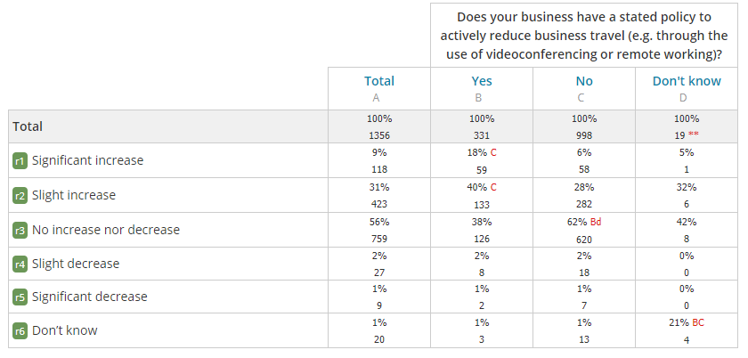
[q25] Considering the past five years, has there been a change in the number of staff in your business working flexibly (e.g. from home or other remote locations) during work days?
Strong correlation between firms who have seen an increase in the number of staff working flexibly and those with a stated policy to reduce business travel
[q26] Does your business have a stated policy to actively reduce business travel (e.g. through the use of videoconferencing or remote working)?
Workforce Survey 2017
BASE: (Total: N = 1356)

Slide 30
[q27] Does your business offer any of the following travel benefits to staff?
[q27] Does your business offer any of the following travel benefits to staff?
Workforce Survey 2017
BASE: (Total: N = 1294)

Slide 31
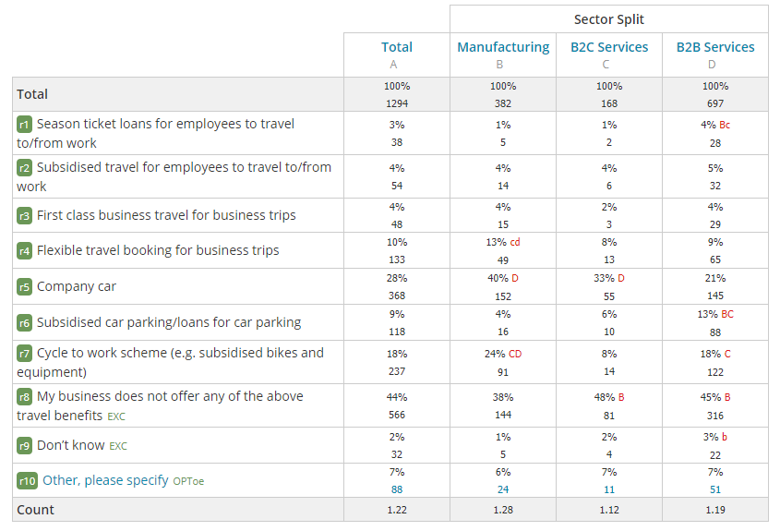
[q27] Does your business offer any of the following travel benefits to staff?
Manufacturers more likely to offer travel benefits to staff
[q27] Does your business offer any of the following travel benefits to staff?
Workforce Survey 2017
BASE: (Total: N = 1294)

Slide 32
[q28] Which, if any, of the following would do most to improve the productivity of your staff travelling by public transport?
[q28] Which, if any, of the following would do most to improve the productivity of your staff travelling by public transport?
Workforce Survey 2017
BASE: (Total: N = 1318)

Slide 33
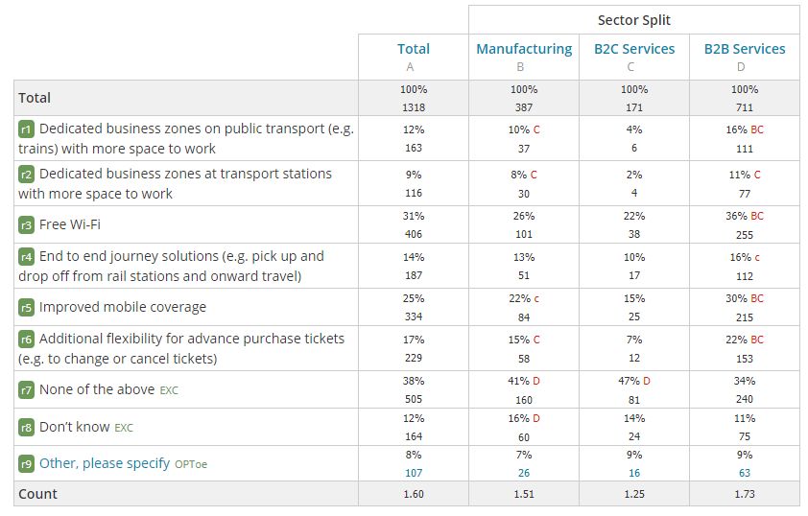
[q28] Which, if any, of the following would do most to improve the productivity of your staff travelling by public transport?
B2B firms more likely to value improvements to public transport
[q28] Which, if any, of the following would do most to improve the productivity of your staff travelling by public transport?
Workforce Survey 2017
BASE: (Total: N = 1318)

Slide 34
[vRegion] Where is your business located?
[vRegion] Where is your business located?
Workforce Survey 2017
BASE: (Total: N = 1461)

